Slide 1
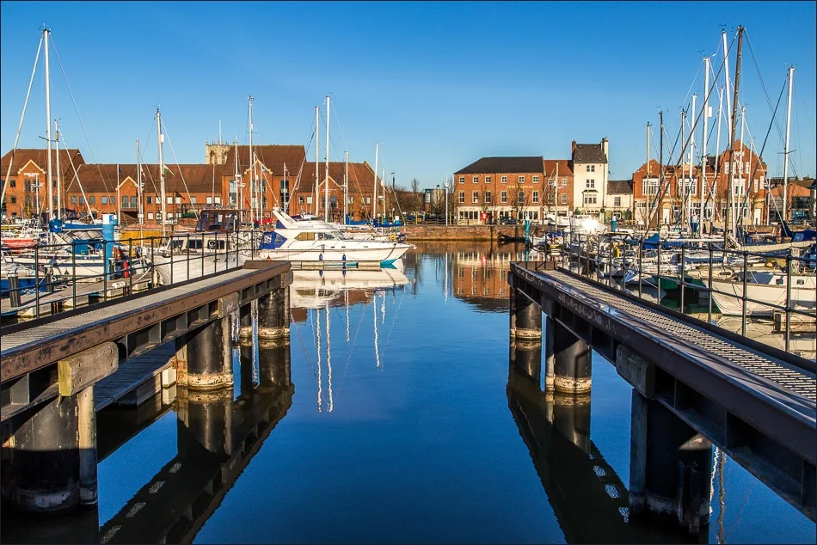



Community Water Safety
Notes:
This Power Point is a collection of useful resources to use as an aid to teaching water safety
It is not intended to be a definitive guide but rather a collection of useful ideas that a facilitator could use to create a tailored presentation for a particular group
Starting in September 2026, water safety education becomes a statutory requirement in England's RSHE (Relationships, Sex, and Health Education) curriculum. Schools must now teach students to recognize risks and stay safe around water using the Water Safety Code, while foundational swimming lessons remain compulsory in Key Stages 1 and 2
Many of the slides would not be used in a basic short water safety awareness presentation but are included to emphasize the wider scope of the topic
Appropriate gratitude and recognition is given to the all those that are endeavoring to reduce the tragic consequences of drownings, in particular RLSS*, RNLI, HFRS, STA, ‘Don’t Become a Memory’ and many international organisations
Using a suitable water environment for practical scenario’s reinforces the impact of the slides
It is appreciated that is not always possible and the presentation can be redacted accordingly
The presentation has intentionally been created so that it can be delivered by any confident facilitator
The slides are brief and introduce ideas and are not intended to replace formal specific training; CPR for example
When completing practical scenarios cognizance of participants water skills, safeguarding, ratios of participant’s, their genders and local environmental conditions must be factored in
To reduce the file size the video links rather than the product are provided, some facilitators may prefer to embed them in the PP for ease when using the resource. The links to these are shown in red on the relevant slide
The worlds climate is changing and heatwaves in the UK are becoming more frequent and extreme making the message of this presentation more pertinent now than ever before.
A challenge in the UK is the shortage of swimming teachers.
Anyone can drown, no one should.
Good luck and let’s hope that the collective efforts make a difference to reducing the death toll
*includes SEND resources

Slide 2
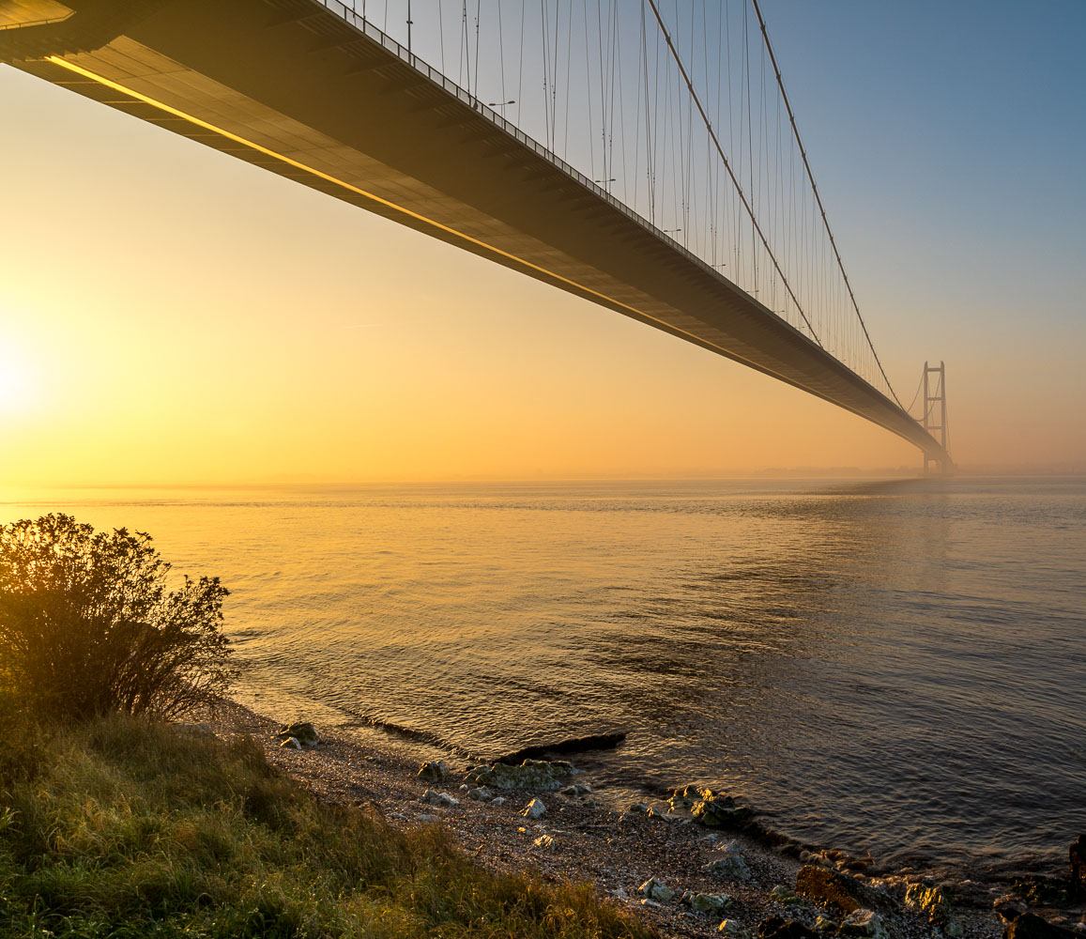
Safe
Around Water
Notes:
Facilitators should provide bespoke local pastoral and H and S information re toilets, fire escapes etc
This training is a summary of useful advice and guidance that collectively if followed will reduce the risk of an unfortunate or tragic incident occurring.
There are excellent resources throughout the web, many are Australian or American, these are easily found and those included are those I liked best.
In UK STA have a plethora of useful resources. See slide ‘Tips for Parents 10’ as that introduces an excellent video that summarises much of this PP
Do NOT make this, too classroom heavy, too technical or frightening
Children engage best with, Stories, Scenarios, Practical challenge and Demonstrations
As the weather is likely to be warm when people seek refuge in cool open waters its worth reinforcing the importance of using sun cream, shade, UV clothing/hats and rehydration when near the water.
Structured programme that could be run from the KKC Clubhouse, the Albert Avenue Lido and other suitable water-based venues
The weekend this initiative was launched in Hull (12.07.26) a teenage boy died in a lake in Lincolnshire (same location another had died a few weeks earlier) and 2 adult males died in the NE whilst trying to rescue 2 children from the sea (the children survived) . Links below
https://www.bbc.co.uk/news/articles/c20yv34453ro
https://www.bbc.co.uk/news/articles/cq81l5gj54zo

Slide 3
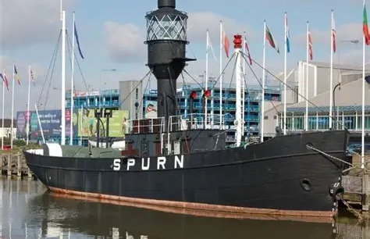
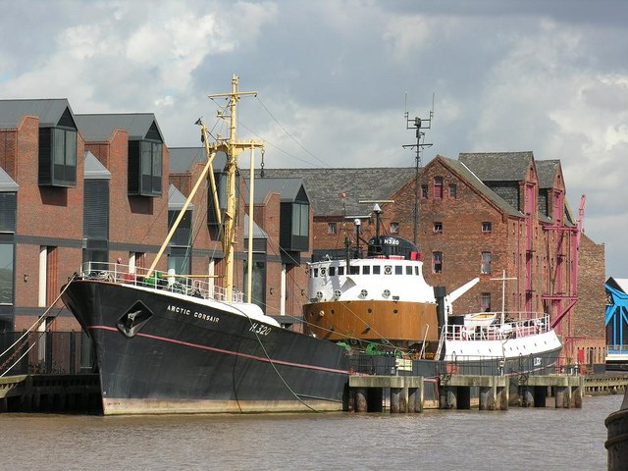
Overview
Response to tragedies Hull Culture and Leisure and the Kingston Kayak Club are delivering open water safety training to young people
‘Float • Think • Survive’
Notes:
Royal Life Saving Society (RLSS) data in the last 5 years indicate 90% of accidental drownings occurred at open water sites, either inland or on the coast.
Globally, more than 230,000 people lose their lives to drowning every year.
In UK around 200 people lose their lives through accidental drownings in open waters each year
Drowning predominately impacts children and young people, with more than nine in 10 deaths occurring in low and middle-income countries, highlighting that vulnerable communities are most at risk.
In the last 5 years, 90% of accidental drownings occurred at open water sites, either inland or on the coast.
Many of these drownings occur due to a lack of knowledge and understanding of open water safety.
According to RLSS UK's National Drowning Report 2023, there is a relationship between warmer weather and an increase in fatal drowning incidents.
46 per cent of drownings occur in the summer months of which 75 per cent are aged between amongst 13 to 17 years old.
Ahead of the school summer holidays, people are being reminded of the risks of open water swimming to prevent serious injury or loss of life.
Statistics show only 25% of Year 6 children in UK (10 to 11 years) can swim meaning that 75% of children leaving primary school can not swim (source Swim England)
The partnership has created a short, practical, memorable course aimed at children and teenagers to help raise awareness of danger and potentially save lives.
The key is:
practical over theory
memorable messaging
confidence without encouraging risk-taking
repetition of a few critical behaviours

Slide 4
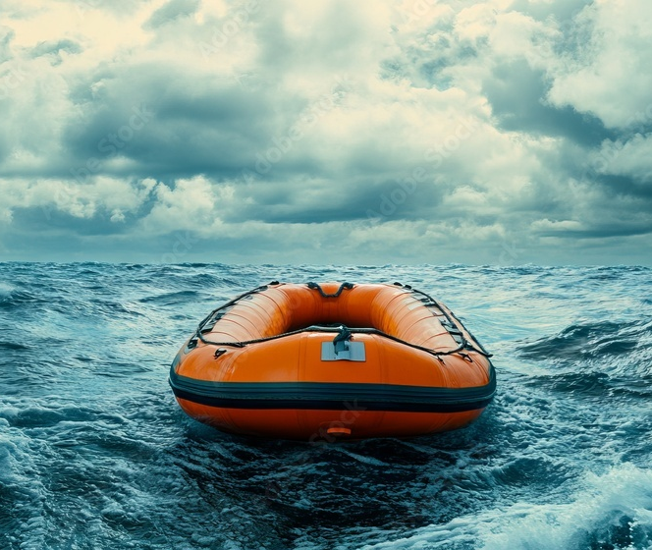
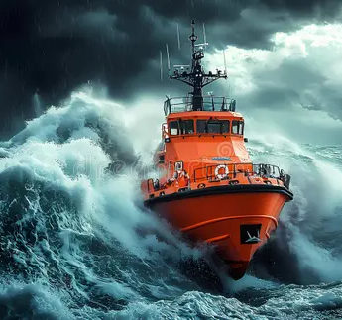
Modern Approach
UK’s approach, led by organisations such as the Royal Life Saving Society, STA, RNLI, and Paddle UK, is built around:
prevention
recognising hazards
floating, not panicking
calling for help
never entering the water to rescue someone
‘Float • Think • Survive’
Notes:
Modern UK water safety guidance increasingly pushes:
Shout
Reach
Throw
Call
Never Go
because it is simple, memorable and works well for children.
The course should feel:
Empowering
Memorable
Active
Serious but fun

Slide 5

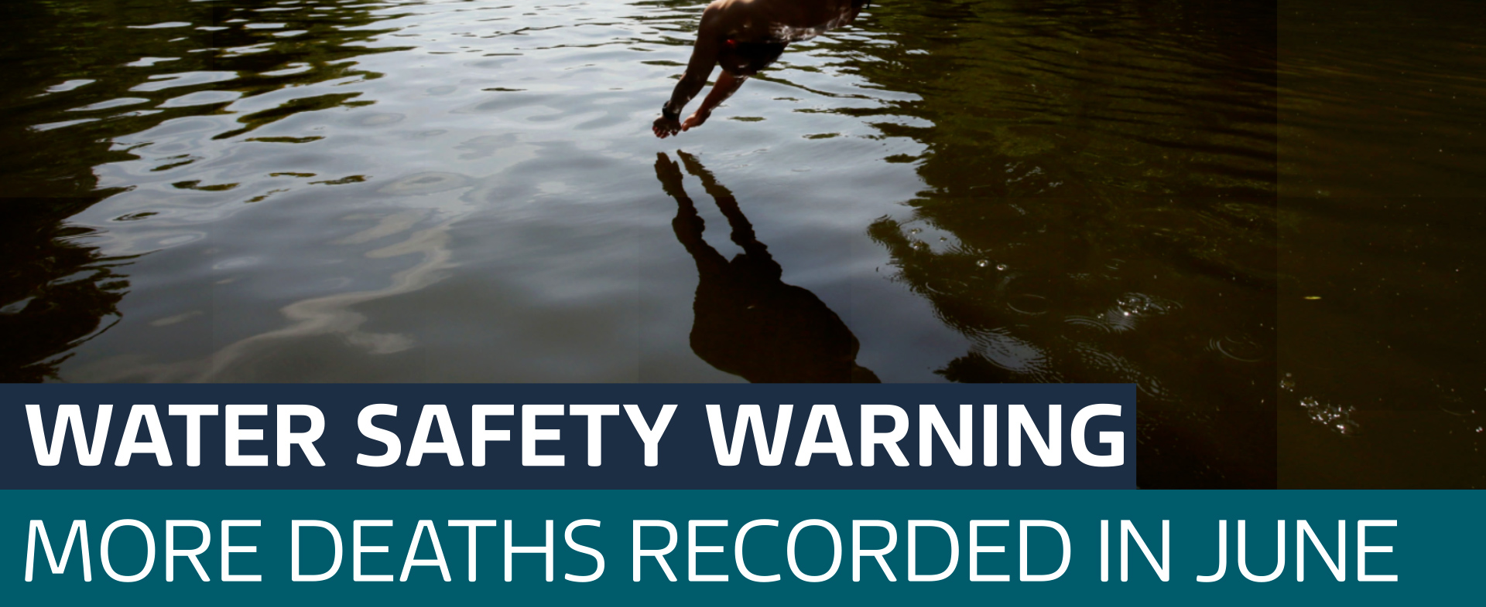
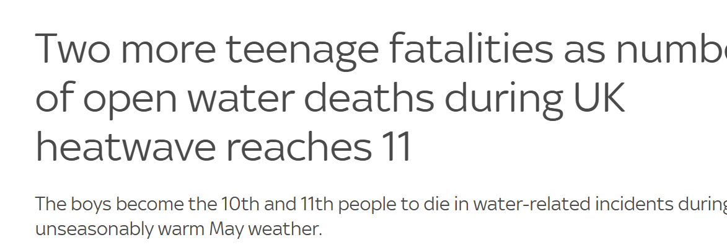
Course Objectives
By the end participants should be able to:
Recognise dangerous water situations
Understand cold water shock
Know how to float to survive
Know how to help without entering water
Know how to call emergency services properly
Understand local Hull-specific water dangers
Leave with confidence, not fear
Notes:
A successful water safety course for ages 8 to 16 must balance vital life-saving knowledge with engaging hands-on practice.
Ideally you should group participants by age (e.g., 8–11 and 12–16) to keep the content development-appropriate.
Core Theory Topics
Theory sessions should be highly visual, interactive, and focused on risk assessment.
The Water Safety Code: Spotting hazards, obeying safety signs, and knowing who to call in an emergency.
Cold Water Shock: Understanding the physical reaction to cold water and the "Float to Live" technique.
Hidden Dangers: Recognizing currents, undertows, sudden depth changes, and water quality issues.
Peer Pressure: Learning how to say no to dangerous water challenges or dares.
Emergency Signalling: Understanding how to attract attention without panicking.
Practical Water Activities
Practical sessions must be conducted in a controlled environment (like a pool) before ever transitioning to open water.
The "Float to Live" Drill: Practicing tilting the head back, keeping the mouth clear, and relaxing to fight cold water shock.
Safe Entries and Exits: Teaching the "slide-in" entry to check depth and debris instead of diving blindly.
Dry Rescue Techniques: Practicing reach-and-throw rescues using ropes, branches, or rescue rings (never swimming out to a victim).
Huddle and Heat Escape Lessening Posture (HELP): Teaching group and individual floating positions to conserve body heat.
Survival Swimming: Practicing sculling, treading water, and swimming fully clothed to simulate real falls.
Ideas of Delivery Methods
1. The "Dry-to-Wet" Progression
Spend the first 25% of the class on land doing interactive theory.
Spend the remaining 75% in the water putting that exact theory into immediate practice.
2. Gamified Learning
Use quizzes, scavenger hunts for safety signs, and role-playing scenarios for the theory parts.
Turn dry rescues into a friendly competition (e.g., who can throw the rescue line closest to a target).
3. Differentiated Coaching
Ages 8–11: Focus on clear rules, memorable slogans, basic swimming competency, and always staying with an adult.
Ages 12–16: Focus on real-world rescue scenarios, risk calculation, leadership skills, and the dangers of alcohol or drugs near water.
4. Scenario-Based Simulations
Create safe, unexpected challenges.
Blow a whistle unannounced and have everyone immediately shift into a survival float or a HELP huddle. Heat Escape Lessening Posture
Safety and Logistics
Ratios: Maintain a strict lifeguard-to-student ratio (ideally 1:8 or better depending on local regulations).
Assessments: Run a quick swim assessment on day one to gauge everyone's comfort level.
Gear: Provide properly fitted life jackets for specific deep-water or open-water simulations. Throw lines, balls, noodles, sticks etc
Core Safety Messages (repeated constantly)
The Four Survival Rules
1. Stop and Think
2. Stay Together
3. Float on Your Back
4. Call 999

Slide 6
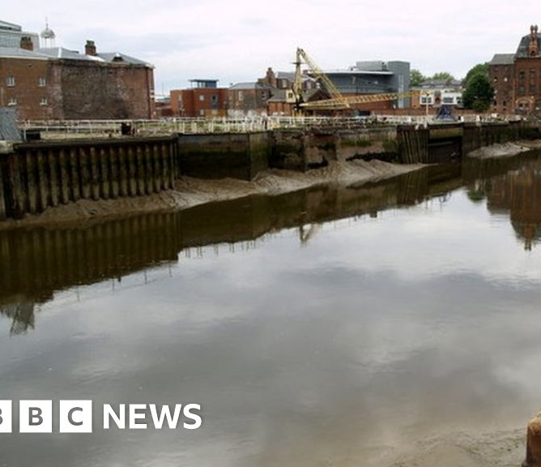
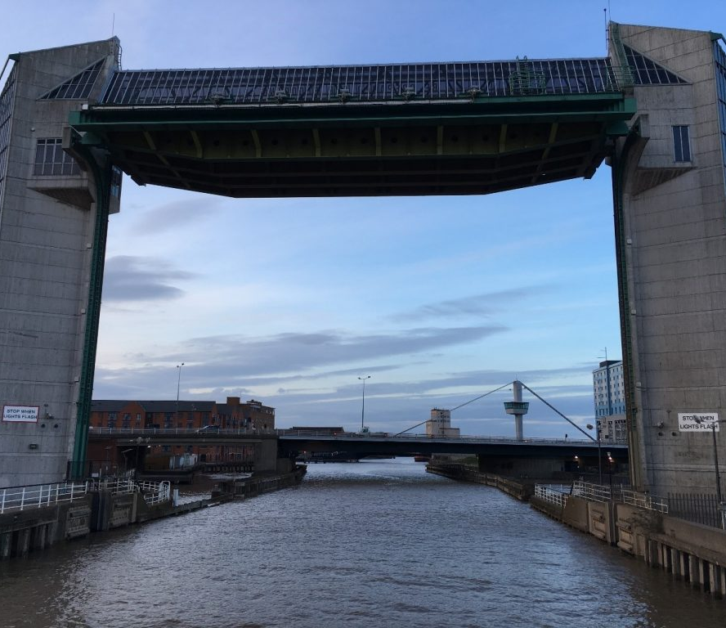
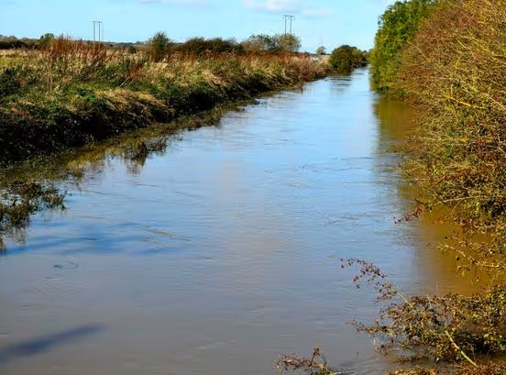
Course Structure
Topics
Why water can be dangerous
Hull’s local waterways
Why strong swimmers still drown
Cold water shock
Hidden dangers
Notes:
Hull is surrounded by risk:
The River Hull
Humber Estuary
Drains, docks, marinas and flood channels
Fishing ponds and lakes
Tidal water
Flood events
Ice covered deep water
Children massively underestimate:
current speed
rip tides
cold
slippery edges
exhaustion
effect of panic
depth of water
debris under the surface
how strong a swimmer they are

Slide 7
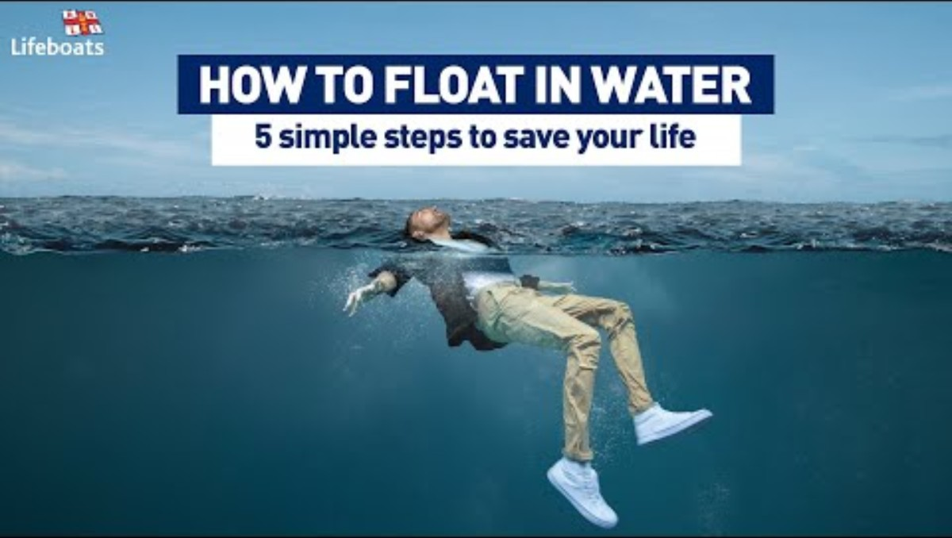
Float to live video
Notes:
https://rnli.org/water-safety/float
Why floating helps you survive
Floating give you the chance to rest and recover your breathing. Once you’ve regained control of your breathing, you can call for help or swim to safety.
It has helped save the lives of more than 50 people in all sorts of situations. From children in rip currents to runners falling into canals, from people swept out by waves, to fisherman falling overboard.
However, you got there, if you end up in difficulty in the water, 5 steps to know how to float
Float to Live.
1- Tilt your head back submerging your ears.
2 - Relax and control your breathing.
3- Move your hands and legs to help you stay afloat.
4 - Your legs may sink - that's OK everyone floats differently.
5 - Find your float by practising at a supervised location.
(This is the single most important part. Teach the RNLI “Float to Live” technique)
Teaching Script:
When cold water hits you:
your breathing goes crazy
your heart races
panic makes things worse
The goal is NOT to swim immediately.
The goal is: FLOAT FIRST.
Teach children to:
keep calm
shout reassurance
tell the casualty:
“Float on your back!”
“Kick your legs!”
“Grab the rope!”
“Keep breathing!”
Many casualties survive longer simply because someone helps reduce panic.

Slide 8
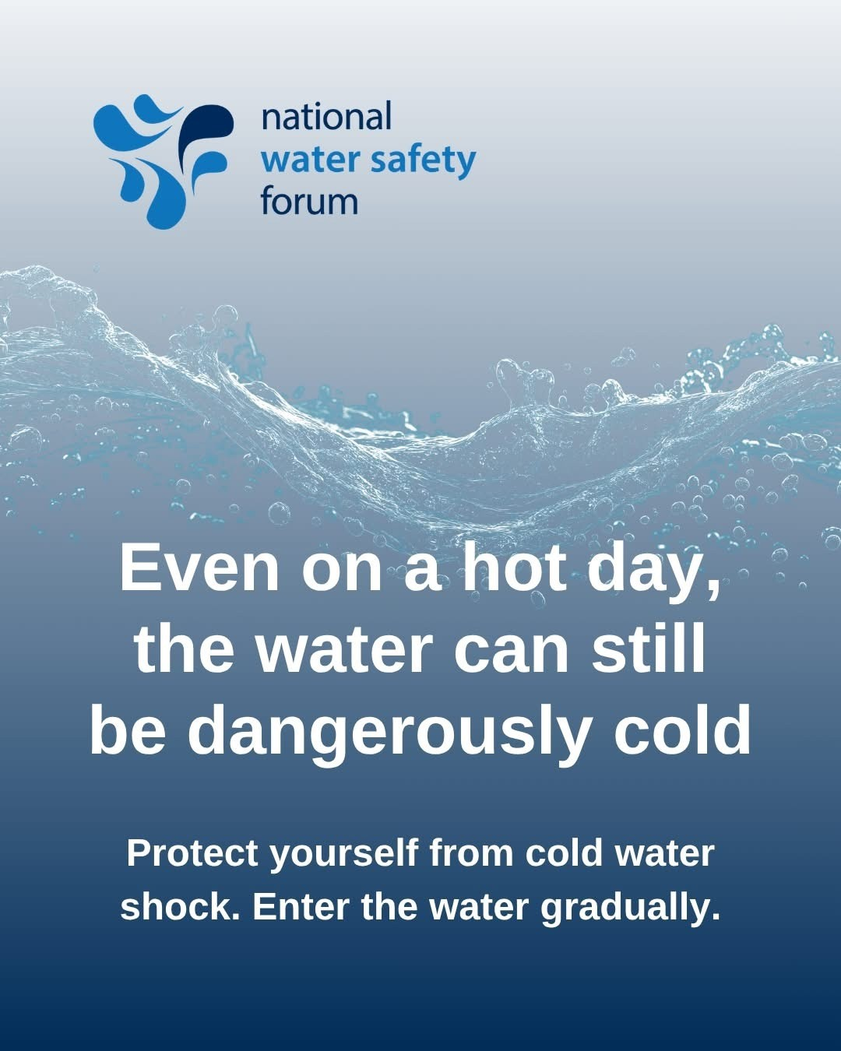
Cold Water Shock
Even in summer rivers and lakes remain dangerously cold,
Water is warmer near the surface but quickly gets colder
Especially true in the Humber, dock, drains and shaded rivers
Notes:
Cold Water Shock?
Trigger: It occurs in water 15°C or below (which includes most UK waters even in summer)
‘Gasp Reflex’: The sudden drop in skin temperature causes an involuntary, uncontrollable gasp for air.
The Danger: Breathing rates can increase up to ten times, causing you to inhale water and panic, which significantly increases the risk of drowning.
Heart Strain: Blood vessels constrict, forcing your heart to work much harder and potentially causing cardiac arrest, even in young, healthy swimmers.

Slide 9
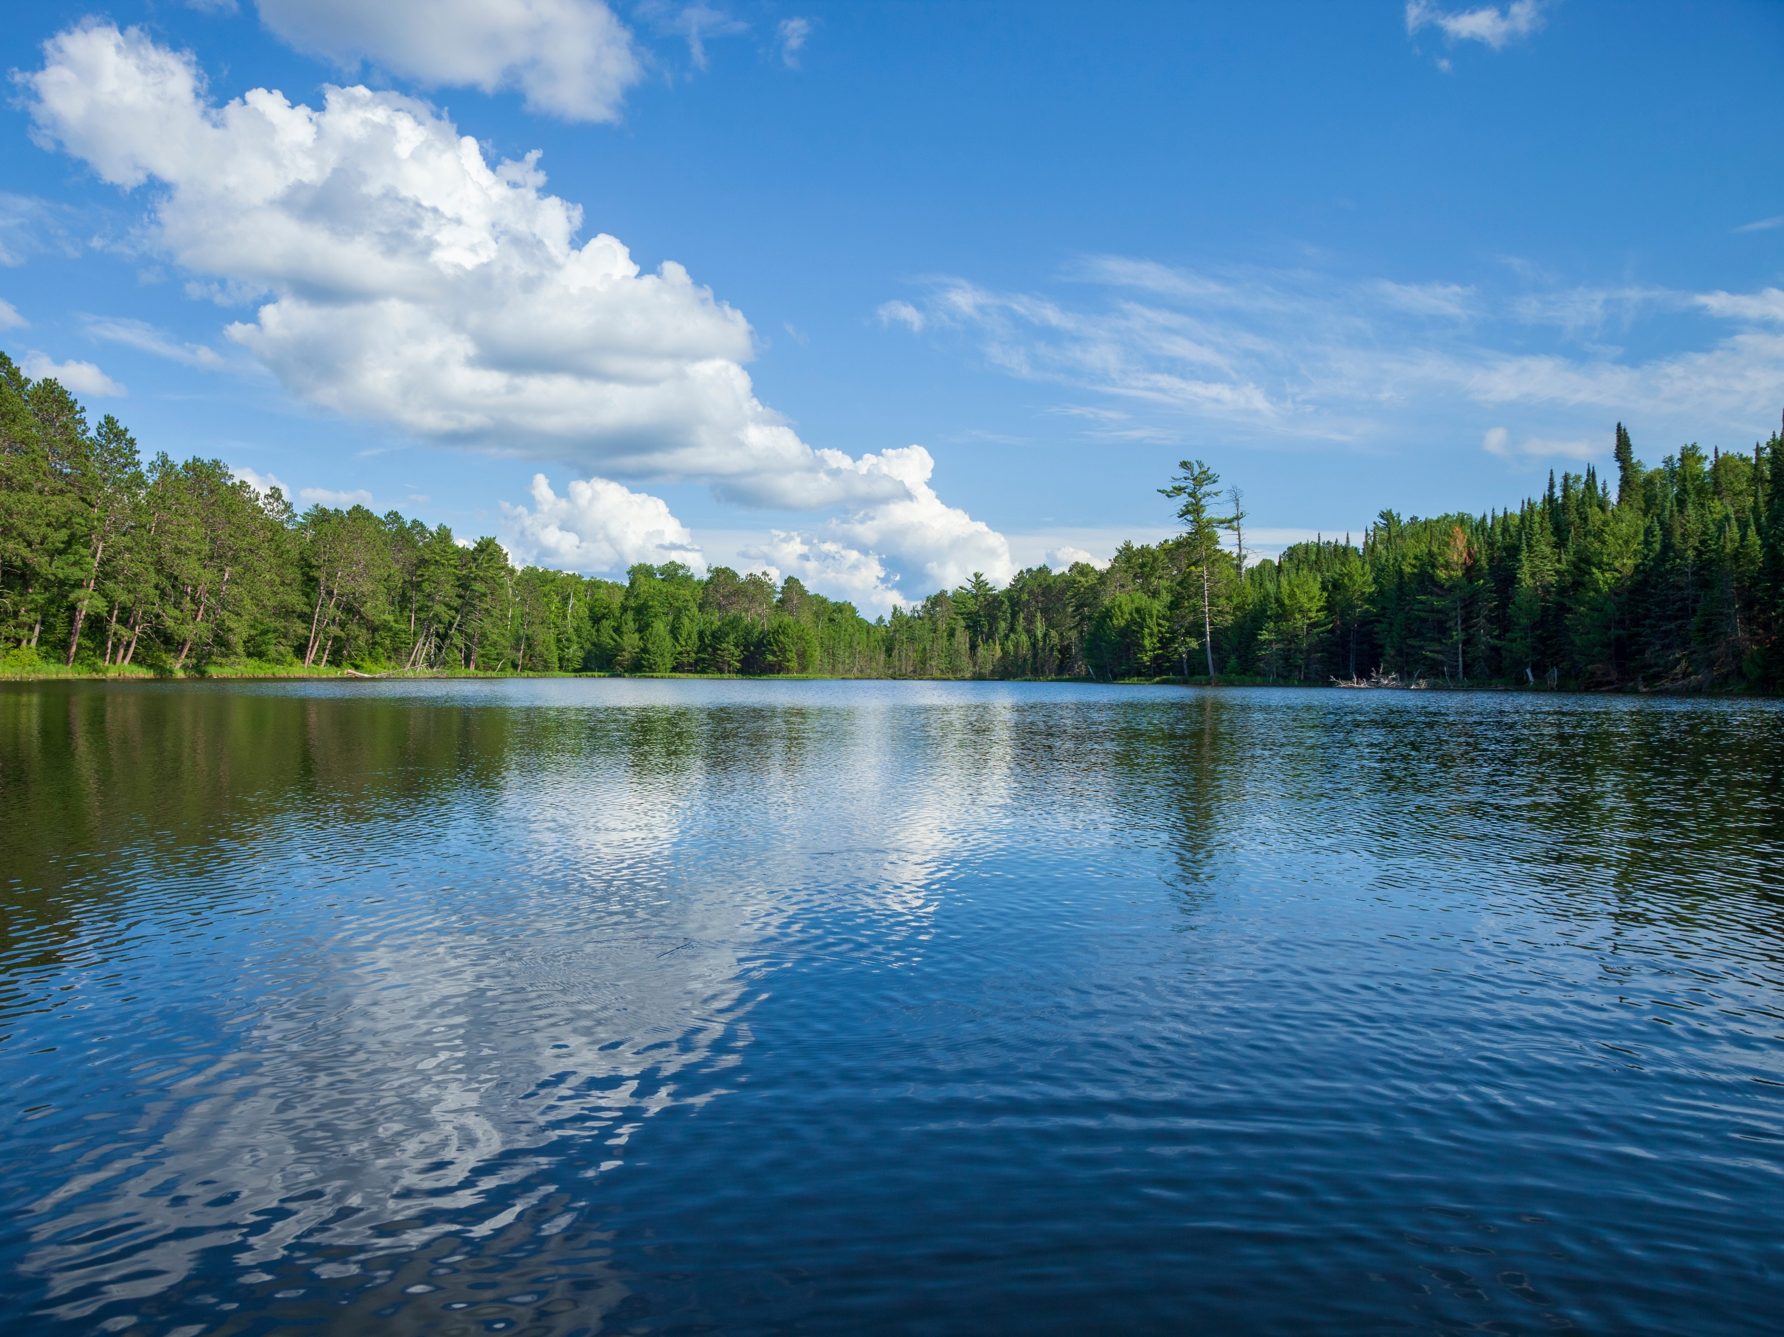
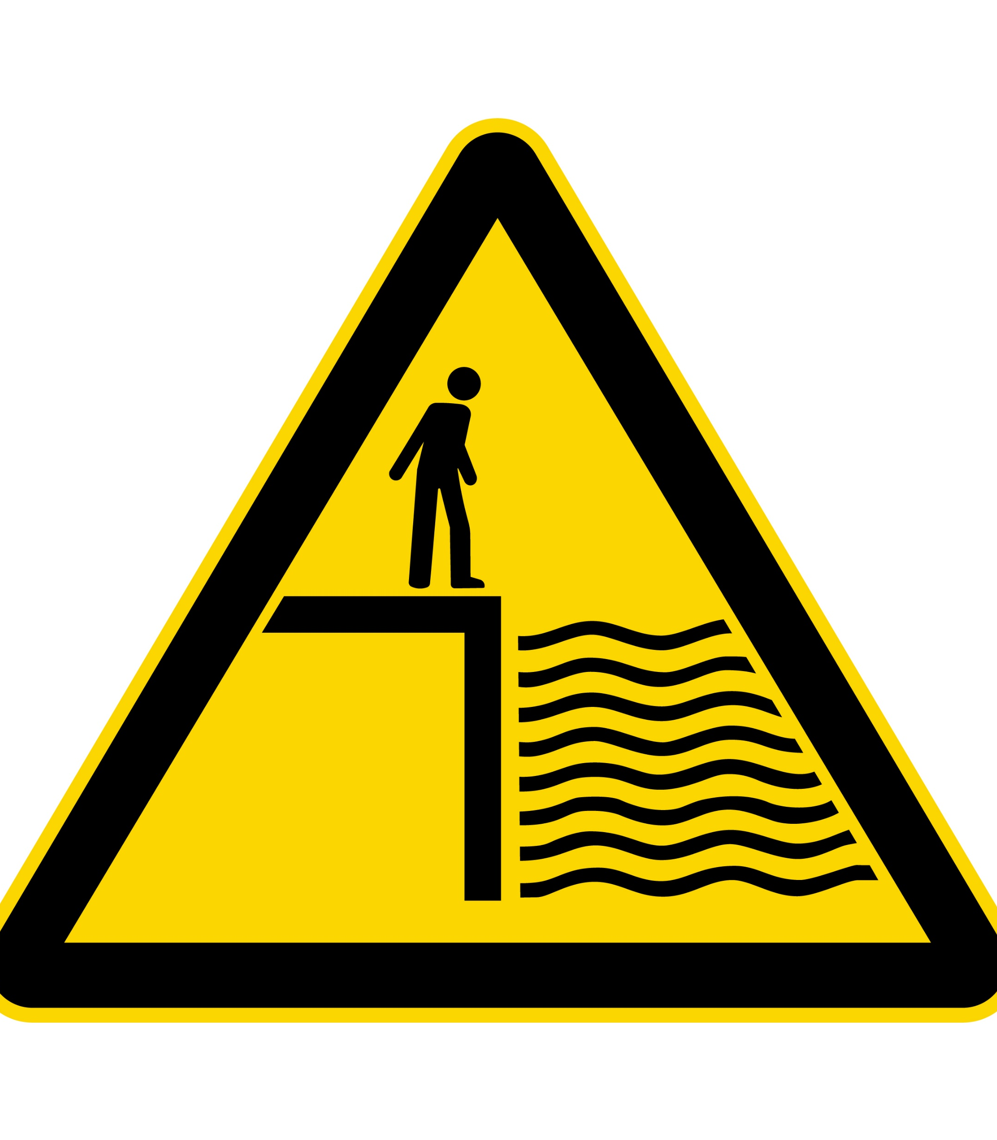
Rescue Without Entering Water
“Shout, Reach, Throw”
Don’t Go
Notes:
This section is essential.
Children naturally want to jump in to help
You must train that instinct out.
See Scenario and Practical slides

Slide 10
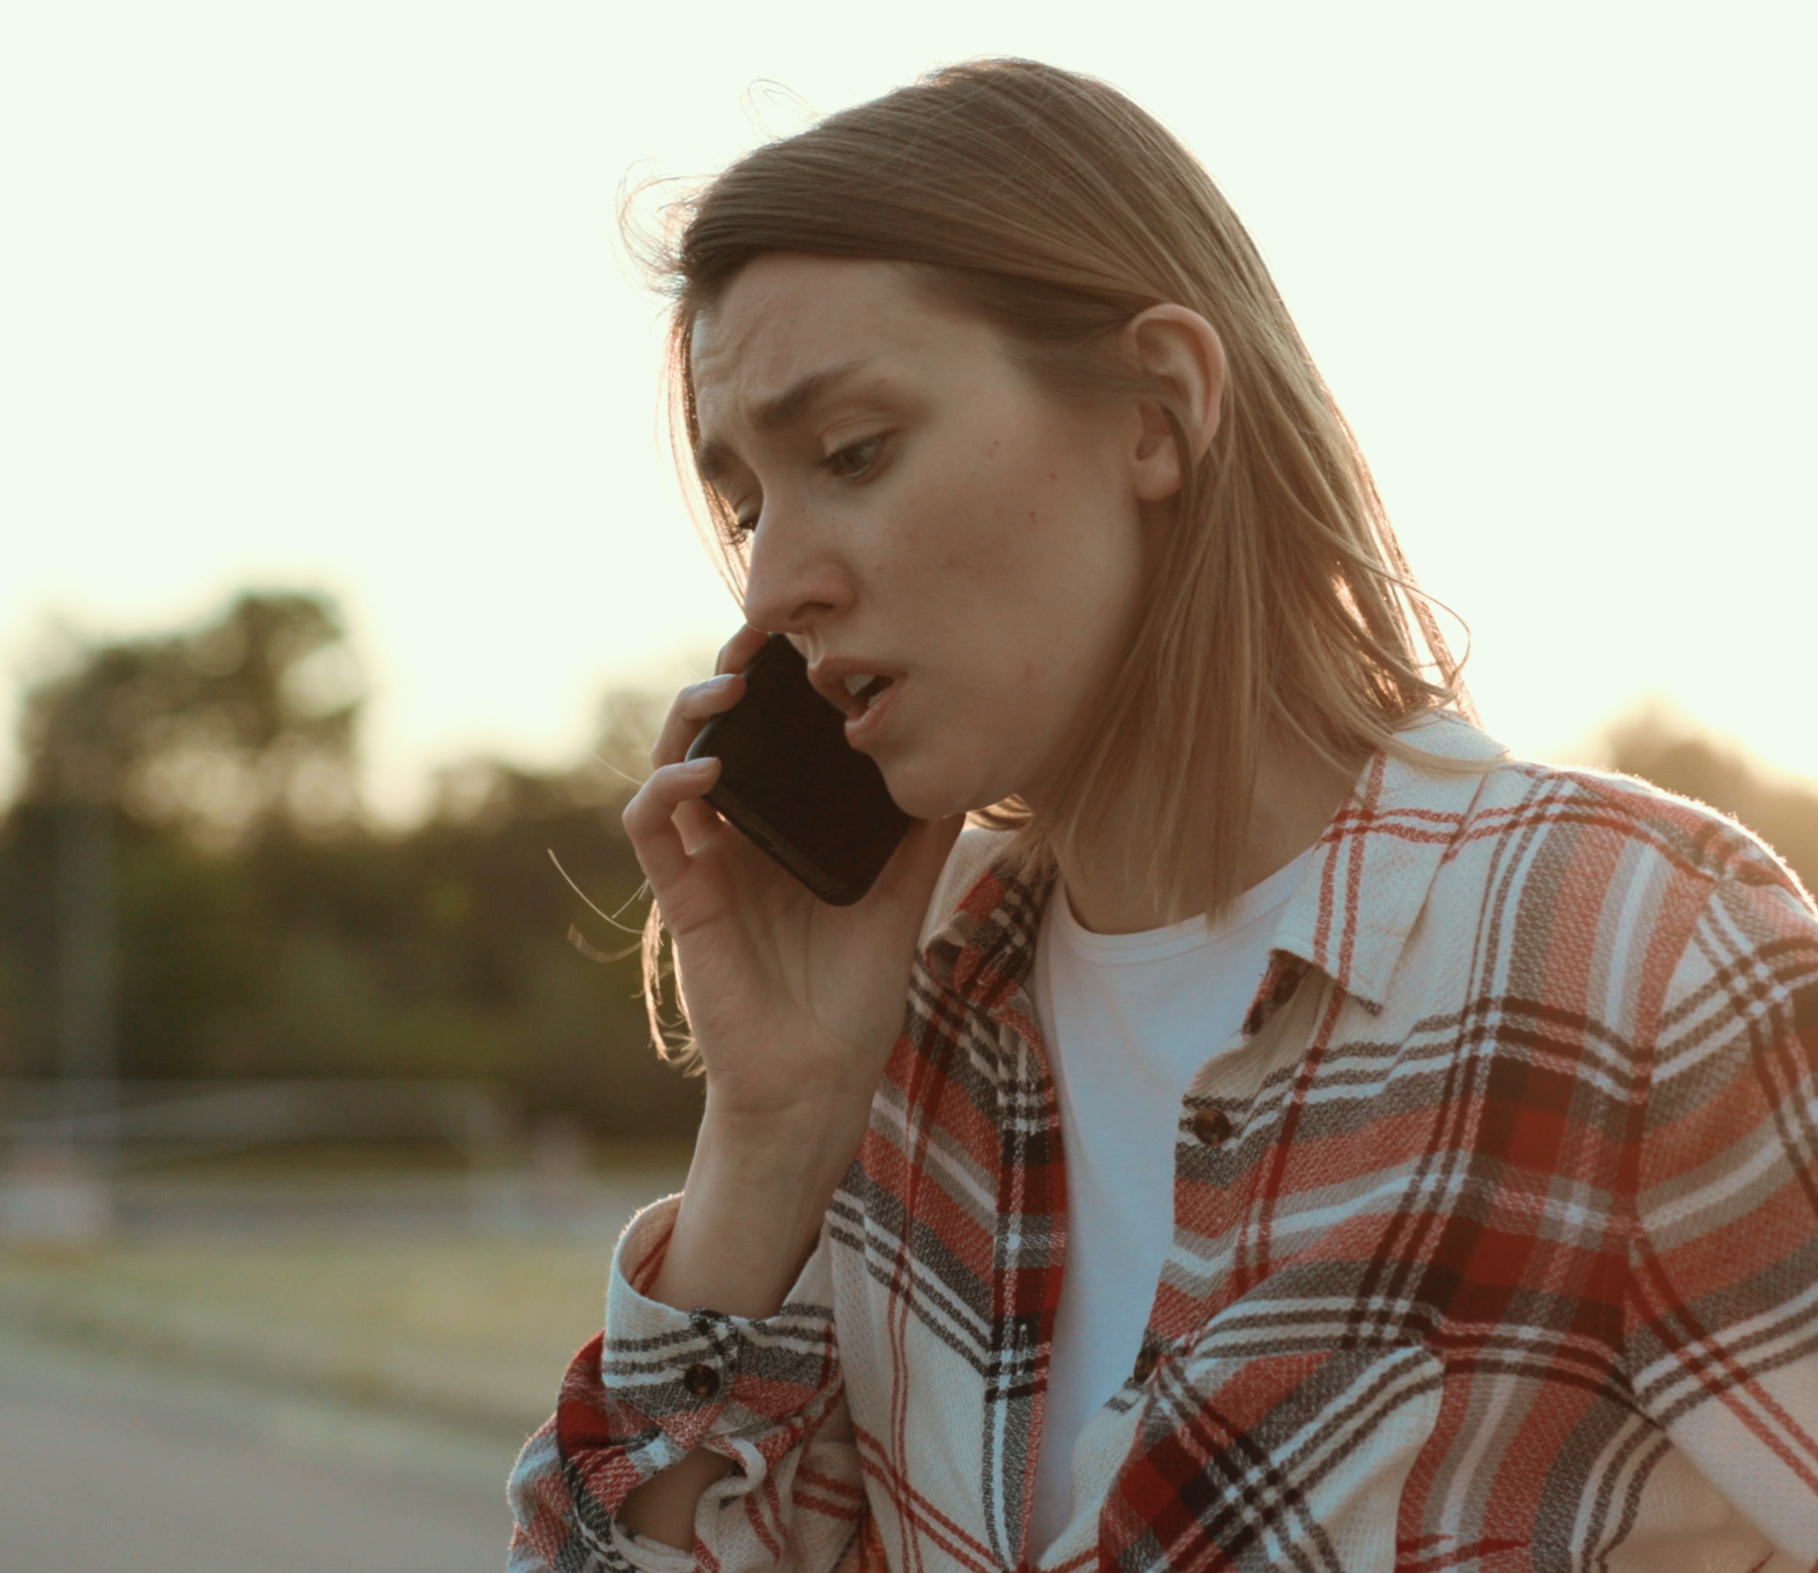

Calling 999
Notes:
(Roleplay emergency calls use walkie talkies, pretend on a mobile)
Teach: to ask for:
Coastguard (if tidal water/Humber)
Fire Service (inland water rescue)
Teach children to say:
exact location (maps, OS coordinates, what three words, what they can see if they don’t know where they are, etc, etc)
what happened
how many people
conscious/unconscious
in water/not in water
Hull - Specific Locations, teach landmark awareness:
bridges
marina
river paths
lock gates

Slide 11
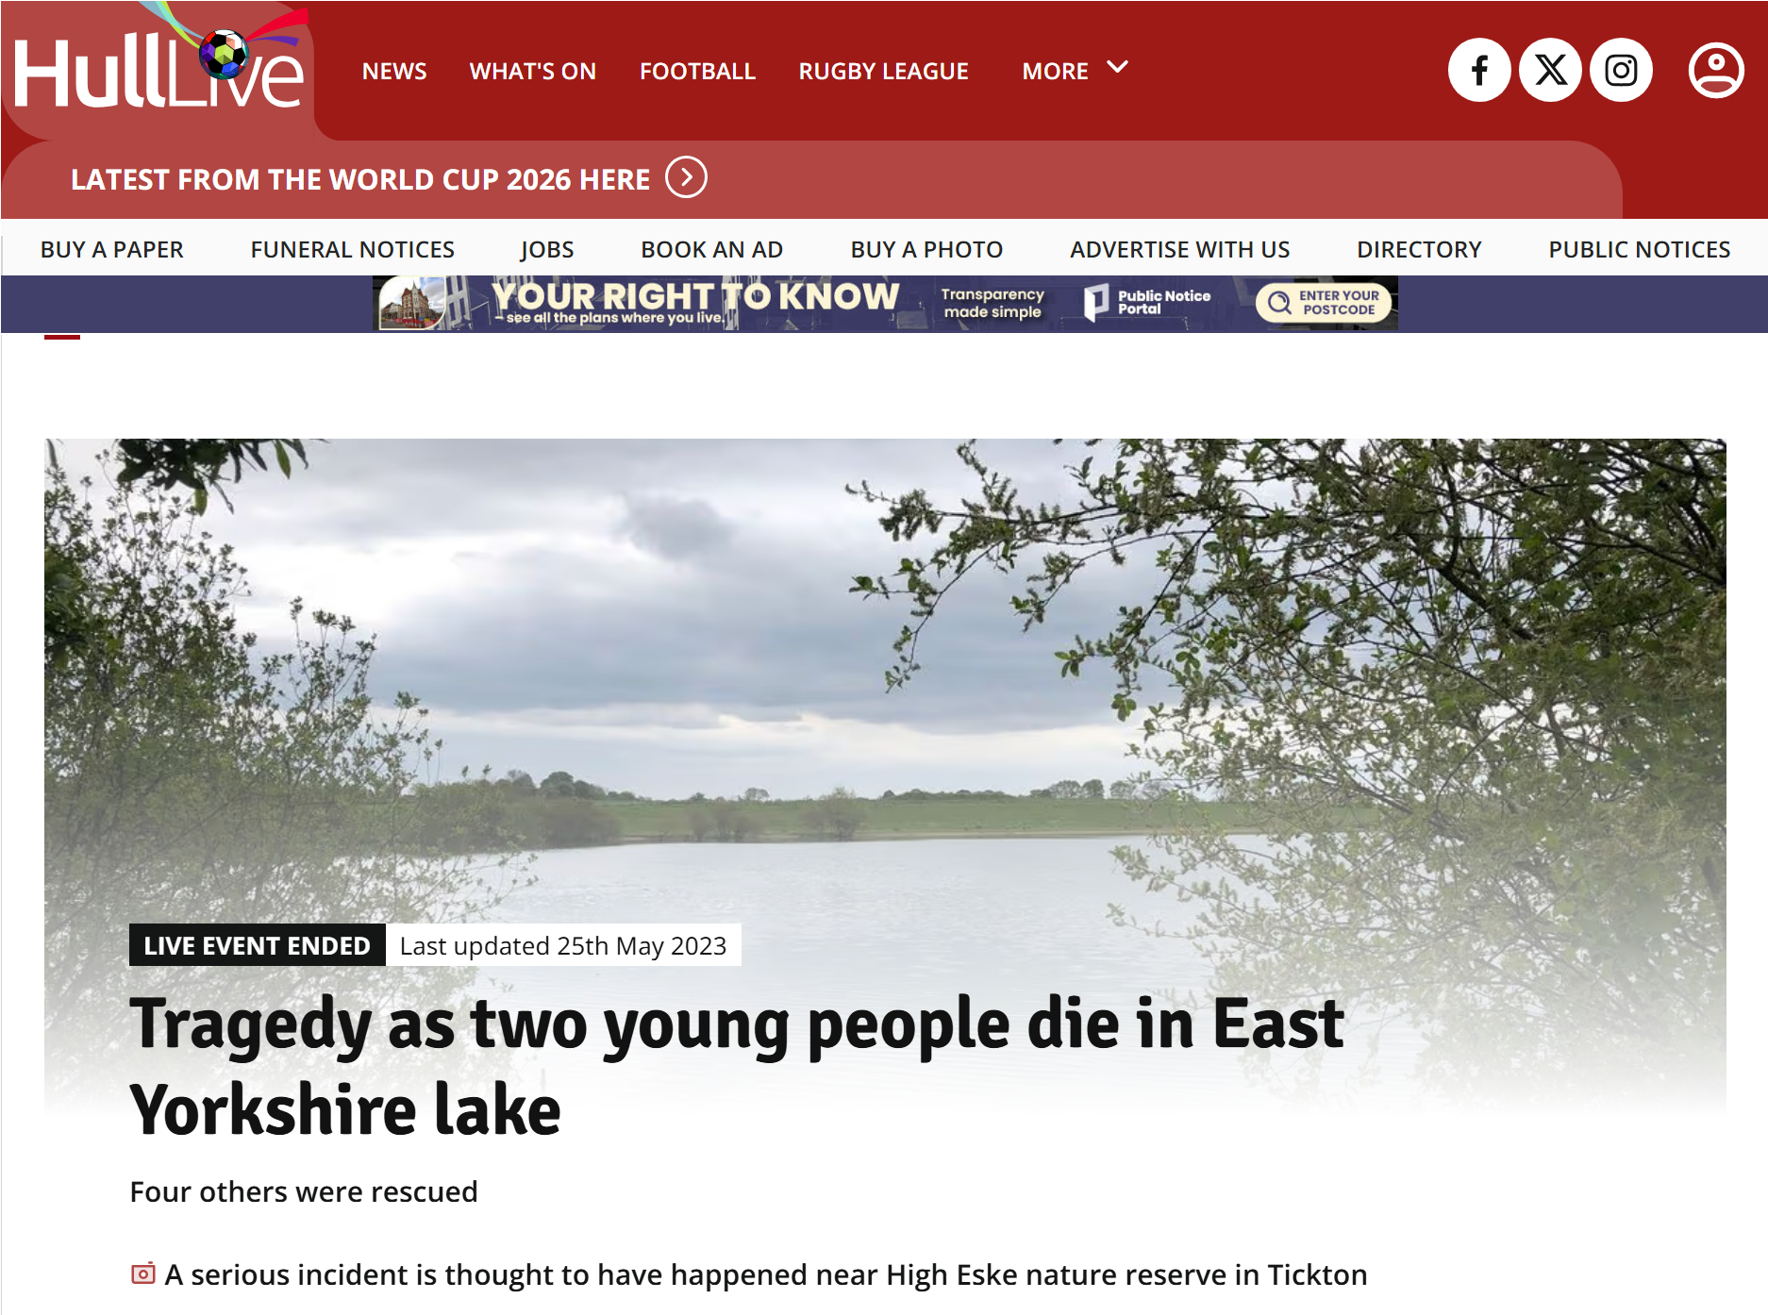
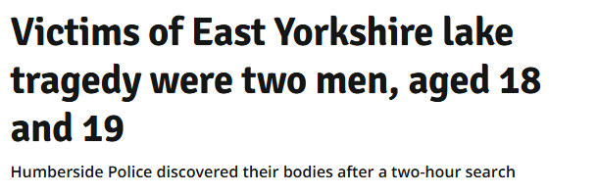
Newspaper headline of High Eske deaths:
Notes:
Two men, aged 18 and 19, drowned at High Eske Nature Reserve near Tickton, East Yorkshire, on May 24, 2023. The pair got into difficulty after entering the water to swim to an island, and despite desperate rescue attempts.
The tragic event unfolded at around 18:30 BST. A group of young people were at the nature reserve, and two men entered the water and attempted to swim out to a small island
The two men who tragically lost their lives were aged 18 and 19 (later formally identified at inquest as Elvicia Neels and Muhammed Batchilly).
The Rescue: Humberside Fire and Rescue were called to the scene and successfully rescued four other people from the lake.
Humberside Police and a diving team conducted a search, and the bodies of the two young men were recovered later that evening.

Slide 12
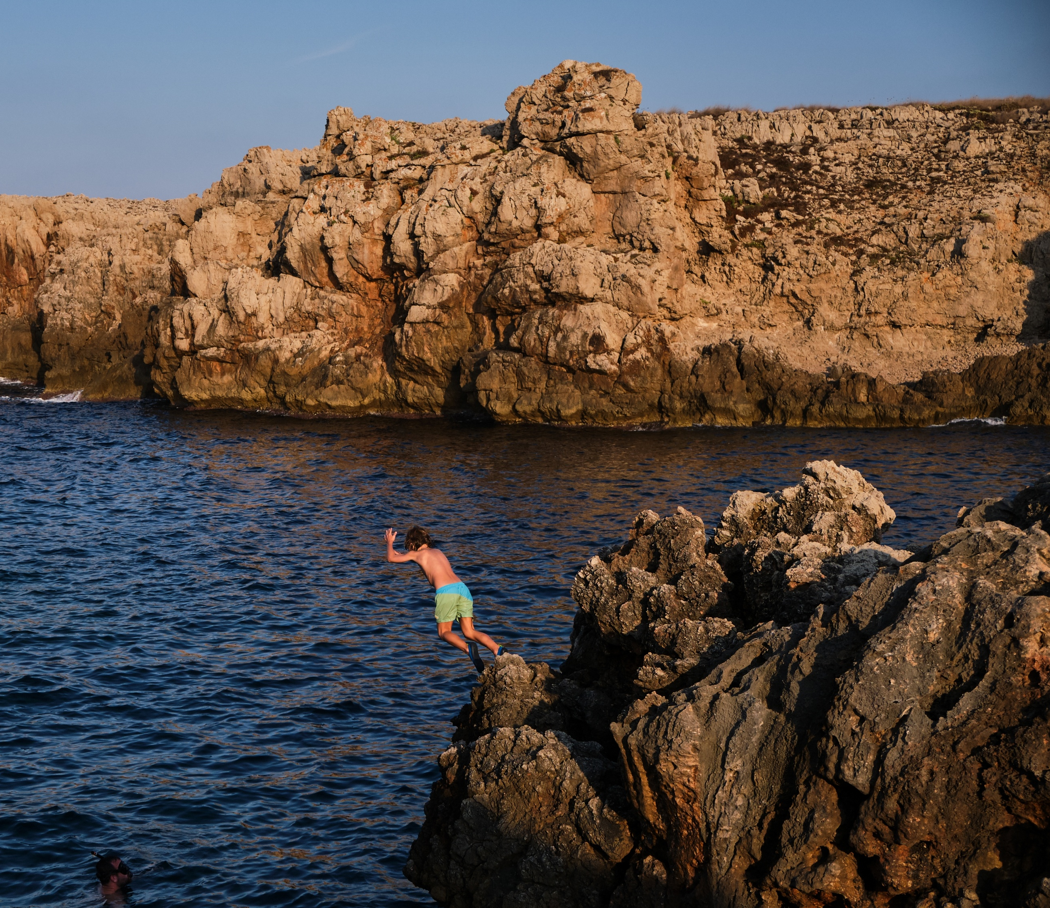
Risky Behaviors Discussion
Notes:
Needs to be age-appropriate and direct.
Discuss:
tombstoning/jumping (not always dangerous)
dares
social media challenges
alcohol/drugs near water
walking home near water
ice dangers in winter
Avoid scare tactics but use realism.

Slide 13
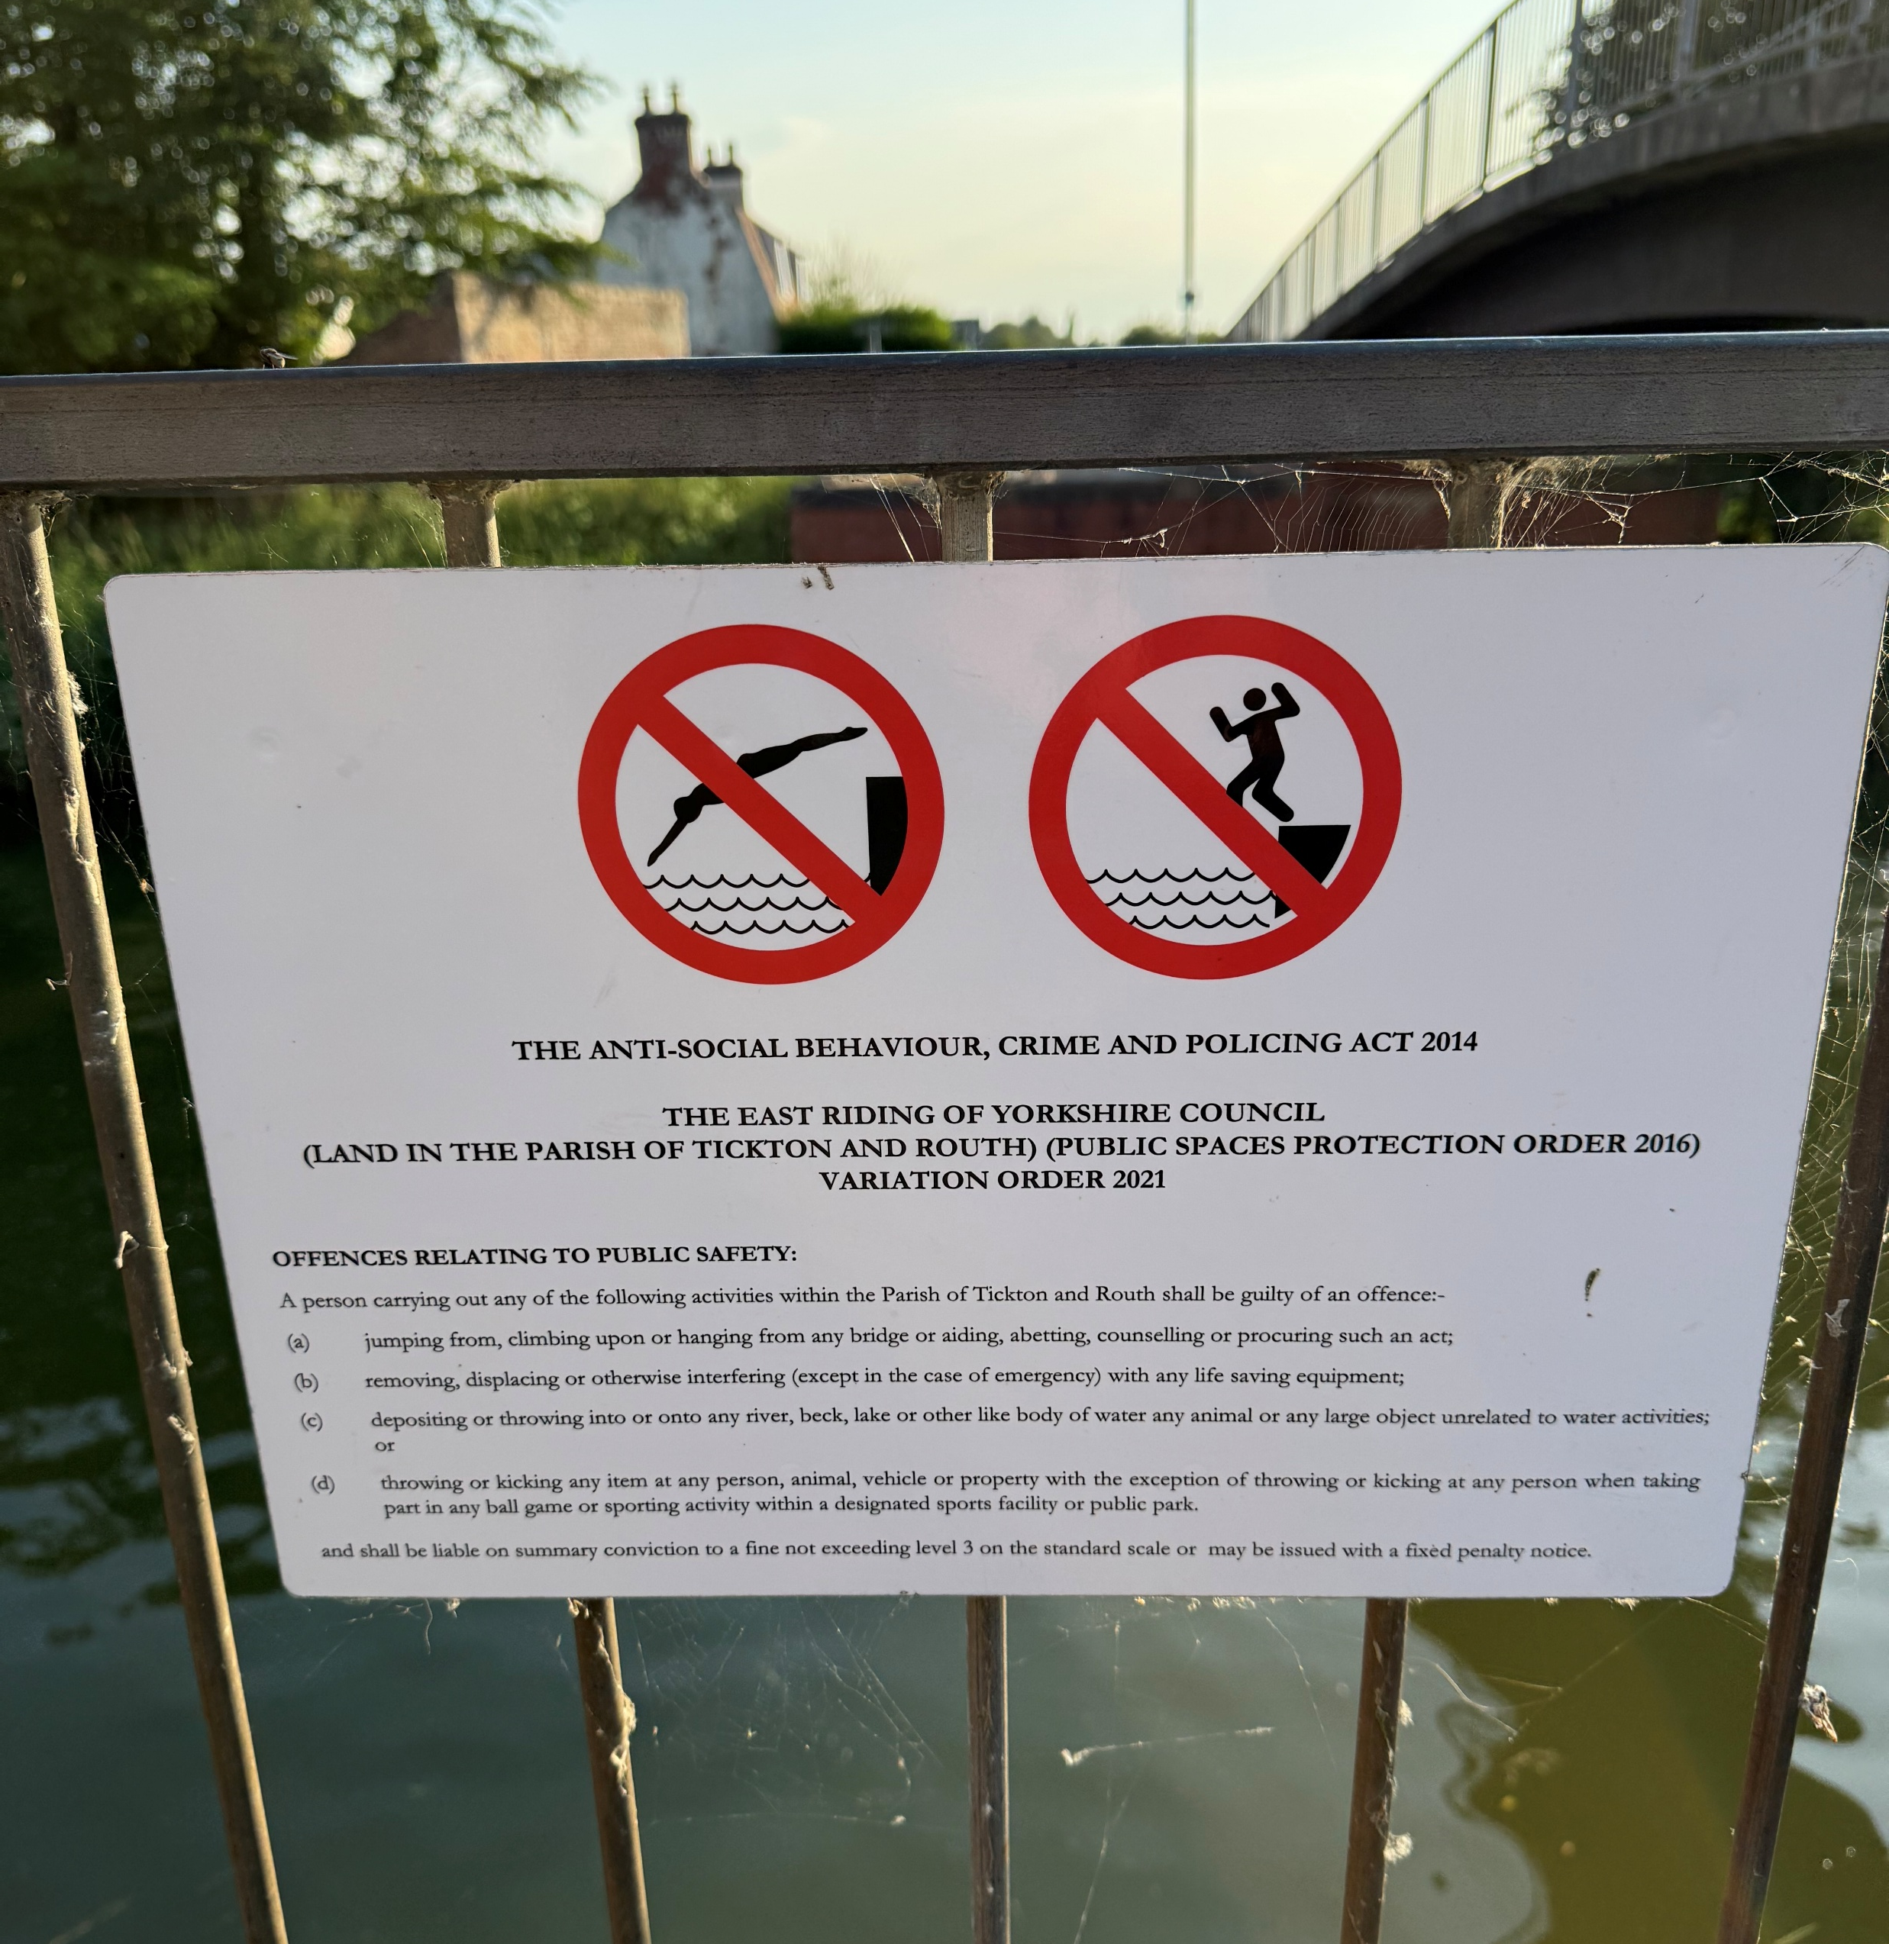
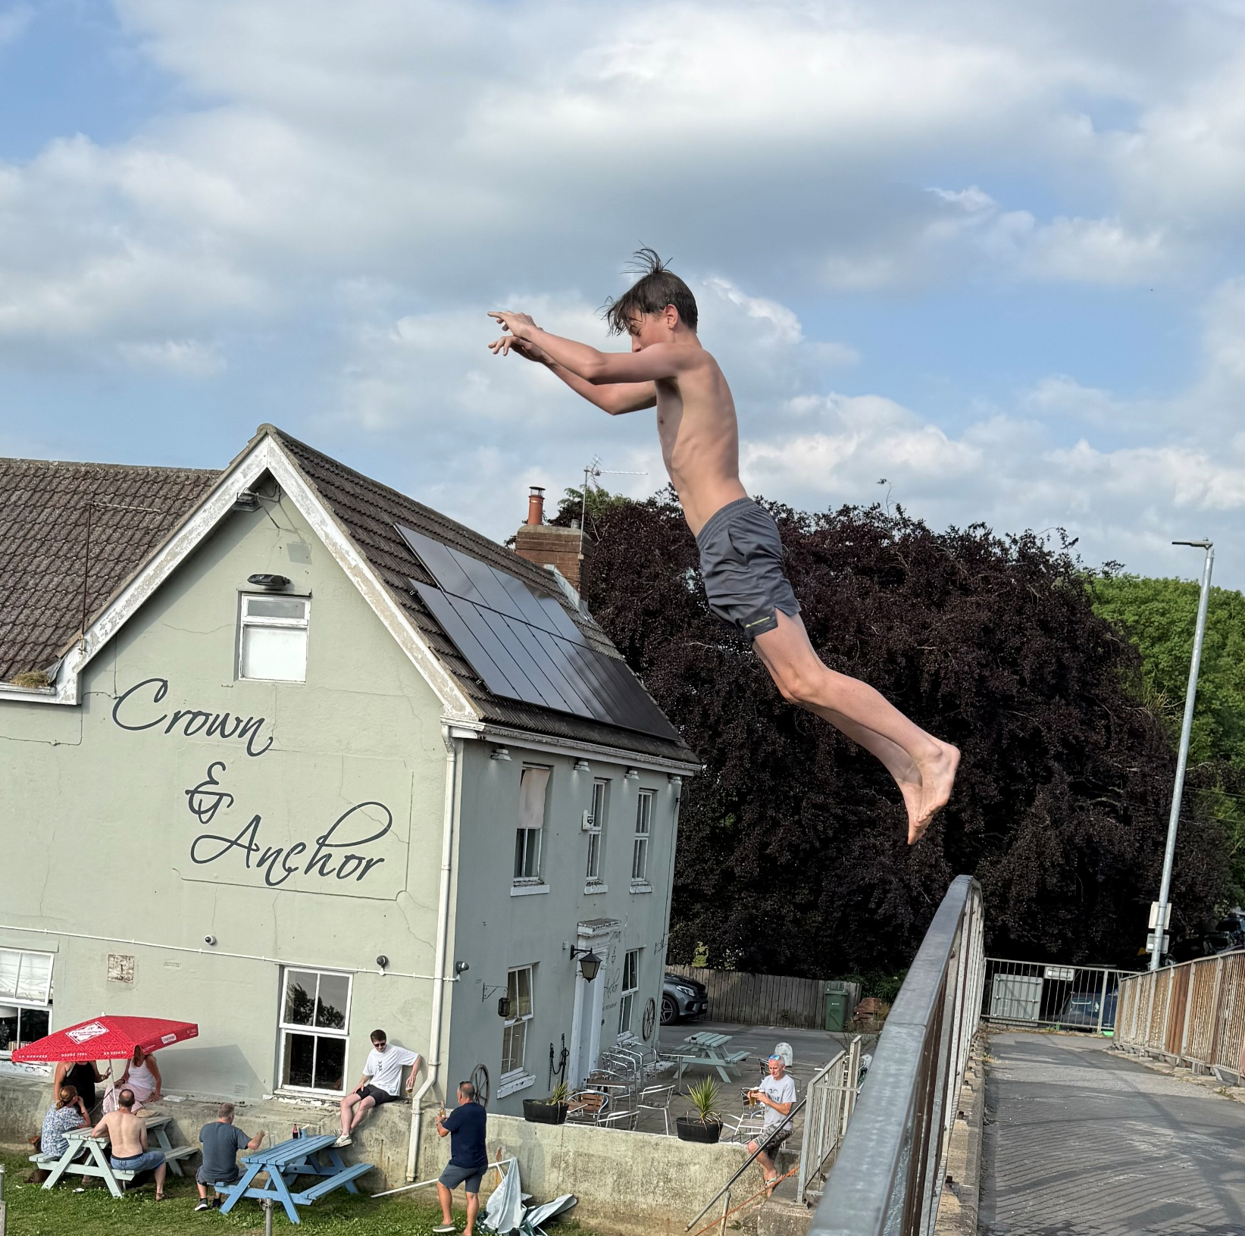
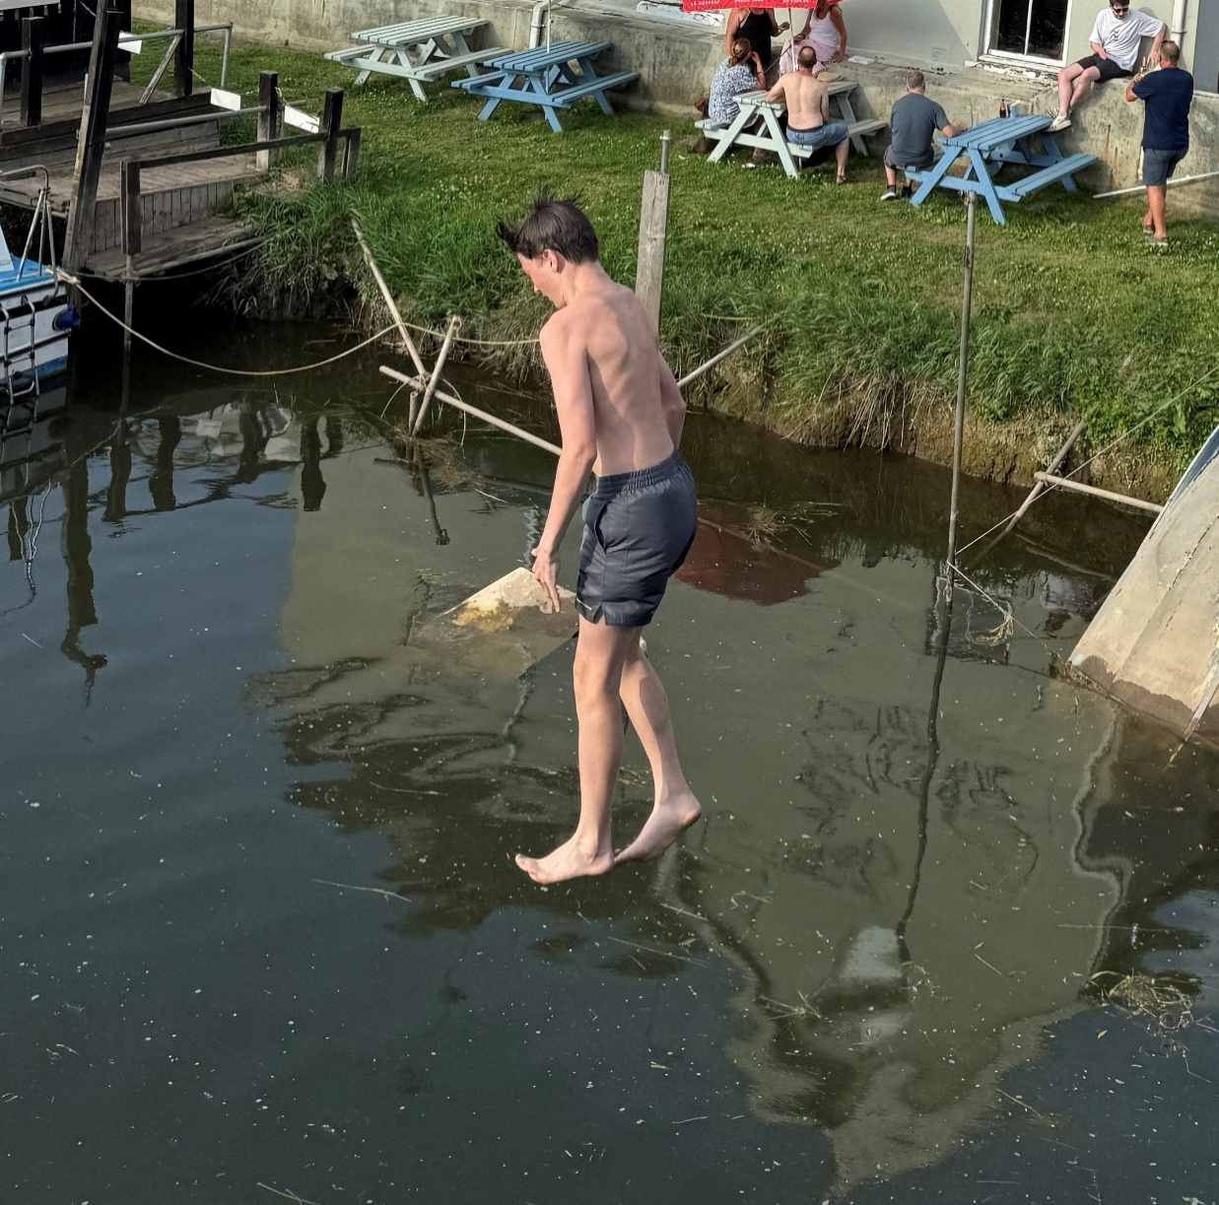
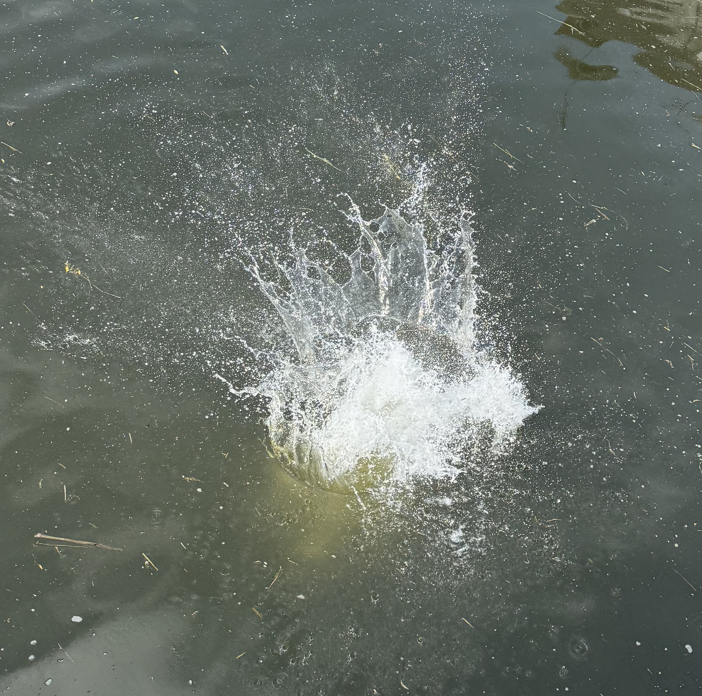
Recently 500m from High Eske scene of double deaths
Notes:
Whilst not condoning this type of activity a pragmatic approach is required understanding that prevention is impossible therefore widening the discussion, training, awareness of the risks and what to do when the inevitable happens is probably a better approach.

Slide 14

Scenario Discussion
“Your friend falls into the River Hull”
“Someone dares you to jump from a dock”
“You slip into cold water while fishing”
“Your football goes into the drain”
What do you do?
Notes:
Children remember scenarios better than lectures therefore group discussion, roleplay and practical scenarios will reinforce learning
Self → Group → Victim → Kit
That order is critical because inexperienced rescuers naturally focus on the casualty first and often become casualties themselves
For children especially, this hierarchy is powerful because it is simple and memorable. Integrate it like this.
The Hull Water Safety Rescue Priorities
SELF
“You cannot help if you become the casualty.”
Check:
Am I safe?
Am I near the edge?
Could I fall in?
Is the water dangerous?
Am I attached to anything?
Call for assistance
Teach:
kneel near edges
never run to the edge
never jump in
stay low
keep escape routes
2. GROUP
“Keep everyone else safe too.”
Children often crowd edges.
Teach:
move others back
stop pushing/panicking
send someone for help
stay together
identify responsible people
This is especially important with peer groups.
3. VICTIM
“Help safely.”
Now use:
Shout → Reach → Throw
Teach:
reassure casualty
encourage floating
avoid direct contact rescues
keep communicating
4. KIT
“Equipment matters least.”
This is a brilliant mindset for paddle sport too.
Children and adults often try to save:
footballs
bikes
pets
phones
fishing gear
scooters
boats/paddles
Teach clearly:
“No object is worth a life.”
Core Teaching Slide
WATER SAFETY PRIORITIES
SELF
Stay safe yourself
GROUP
Protect others nearby
VICTIM
Help safely
KIT
Equipment can be replaced
Add Into Scenario Sessions
Every scenario should start with:
“What order do we think about?”
Children should answer:
Self
Group
Victim
Kit
That repetition builds instinct.
Example Scenario
“A football goes into the drain channel.”
Ask:
What’s most important?
Correct answer:
Not the football
Not getting close to slippery edge
Keeping friends back
Getting an adult
Example Paddle sport Scenario
“A kayak capsizes.”
Priorities:
Self
Group stability
Swimmer rescue
Boat/paddle recovery
This subtly introduces good paddle sport rescue thinking too.

Slide 15
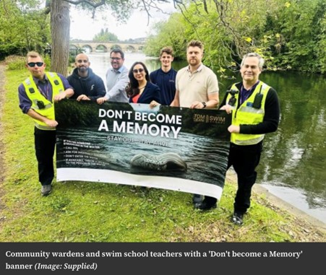
Don’t become a Memory
Notes:
The 'Don't Become a Memory' campaign is a major water safety initiative in the UK. Launched by Olympic swimmer Tom Dean, the campaign aims to prevent drowning and keep people safe around water during the warmer months.
Hull is one of the chosen places for focussing on this campaign and the local driver is Councillor Jessica Smith Labour Councillor for Southcoates
Key Safety Messages
- Stay out of cold water: Even on hot days, UK rivers and lakes are very cold. This causes cold water shock, which makes it hard to breathe and control your body.
- Avoid strong currents: Hidden flows can easily pull swimmers under the water.
- Never drink or use drugs and swim: Alcohol and the effects of drugs change your judgment and slows your reflexes.
- Do not try to be a hero: If a friend falls in, do not jump in after them. Instead, call for emergency services or throw them a float.
Why the Campaign Matters
Tragically, many water-related deaths happen every summer to people who do not know the dangers of open water. The campaign warns the public to think twice before entering dangerous areas. It also pushes local groups and schools to educate young people about how quickly a fun swim can turn into a tragedy.
https://www.yorkpress.co.uk/news/26122836.olympic-swimmer-tom-dean-drowning-prevention-campaign/

Slide 16
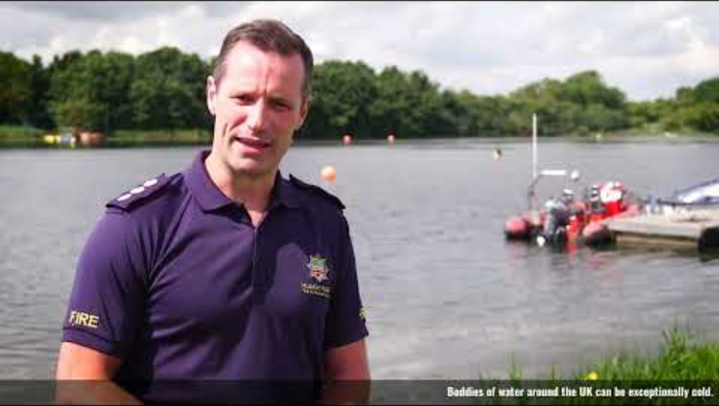
Questions & Learning Outcomes
Notes:
At the end participants should be able to:
✅ Explain cold water shock
✅ Demonstrate floating
✅ Throw a rescue aid safely
✅ Call 999 correctly
Beware what lurks beneath
https://www.youtube.com/watch?v=5jCeRrG9p-0

Slide 17
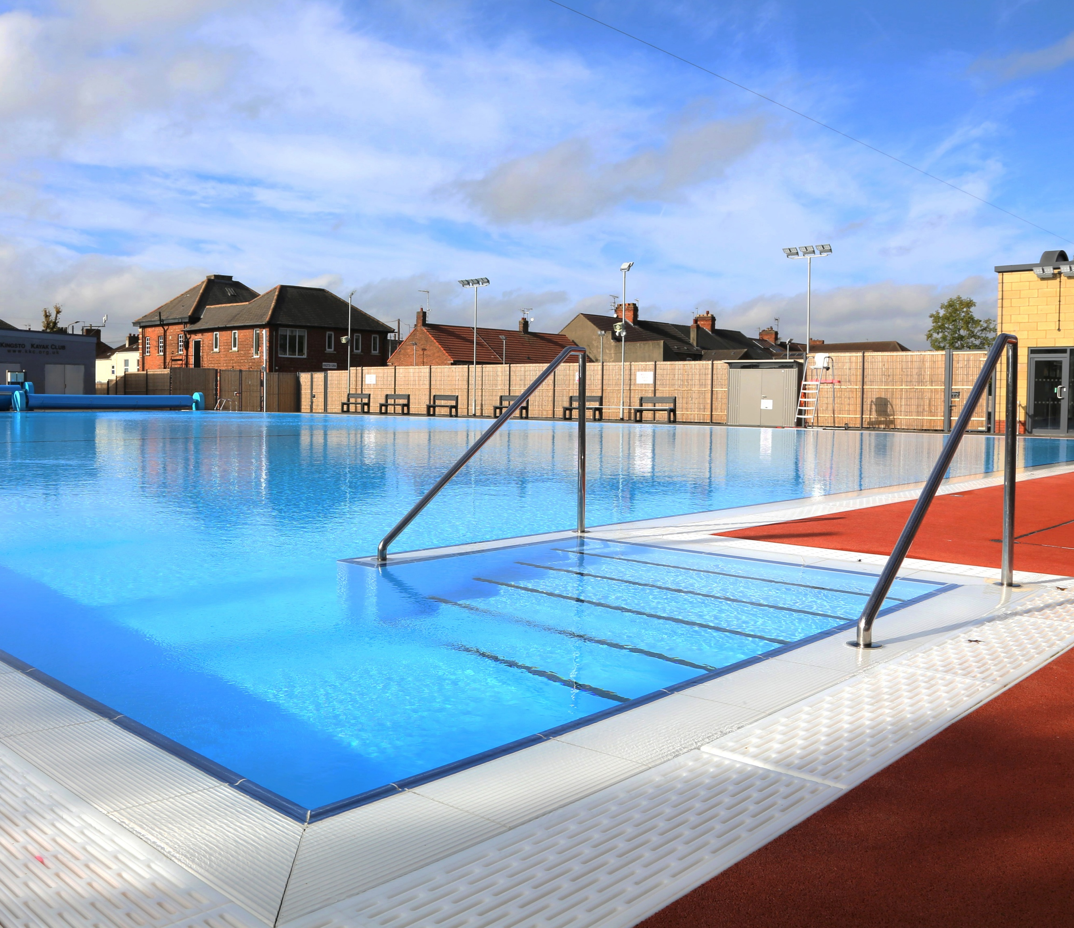
Practical
Time to get changed and put into practice your new skills!
Notes:
The Hull Water Safety Rules
1. Stop & Think
Don’t panic. Assess the danger.
2. Stay Together
Never enter water alone.
3. Float to Survive
Cold water shock kills through panic.
4. Shout, Reach & Throw
Help without entering the water.
5. Call 999
Get professional help quickly.
6. Never Jump into Rescue
Most rescuers who enter the water become casualties too.
(Practical)
Pool Practical participants:
jump or step in safely
practise:
-star float
-back float
-controlled breathing
-light sculling
-regaining composure
Teaching Sequence
-SHOUT
“Talk them through surviving”
-REACH
“Use something long”
Teach:
Paddles
Poles
Towels
throwline tails
branches
clothing
Children kneel safely and brace themselves, extend object and pull carefully
Critical Rule
Never lean too far and never get pulled in
THROW
“Anything that floats”
Teach use of:
- throw bags
- lifebuoys
- footballs
- empty bottles
- kickboards
Participants practise, throwing accurately, communication and pulling safely
Practical Activities using poolside:
throw line practice
reaching with poles/paddles
shouting reassurance
getting help quickly
Equipment
-throw bags (may need to buy some)
-buoyancy aids
-ropes
-paddles
-poles
-lifebuoys

Slide 18
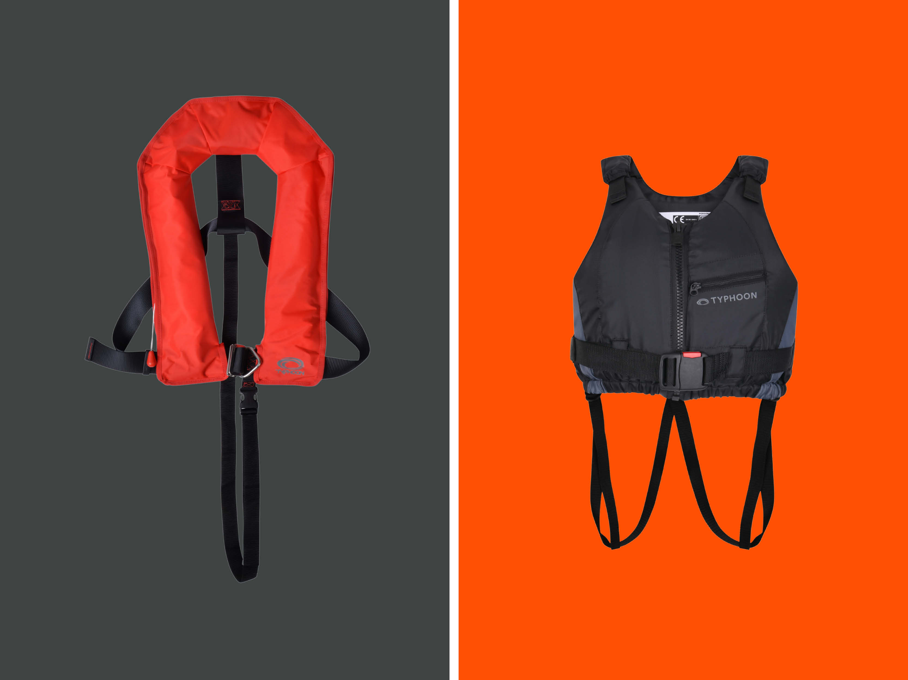
Lifejacket/BA Session
Differences between a buoyancy aid and a life jacket
Notes:
Teach:
how to wear one properly
why cheap/badly/old fitted buoyancy aids fail
difference between life jacket and BA
Buoyancy Levels measured in Newtons (1 is roughly equivalent to 1 kg of lift)
Safety Standard approval markings
EN ISO 12402-5 (International Standard)
CE UKCA (Passed test for UK and European standards)
EN 393 (Older markings still safe if foam is in good condition)
Intended use – sheltered water, help close by, user weight
Inspection of; foam (not waterlogged or cracked), clips and straps (rust, cracks and weak stitching), manufacturers' advice
SOLAS (the International Standard for the Safety of Life at Sea) must include specific markings indicating; manufacturers information, name and contact details, certification marks, symbols indicating SOLAS approval and compliance

Slide 19
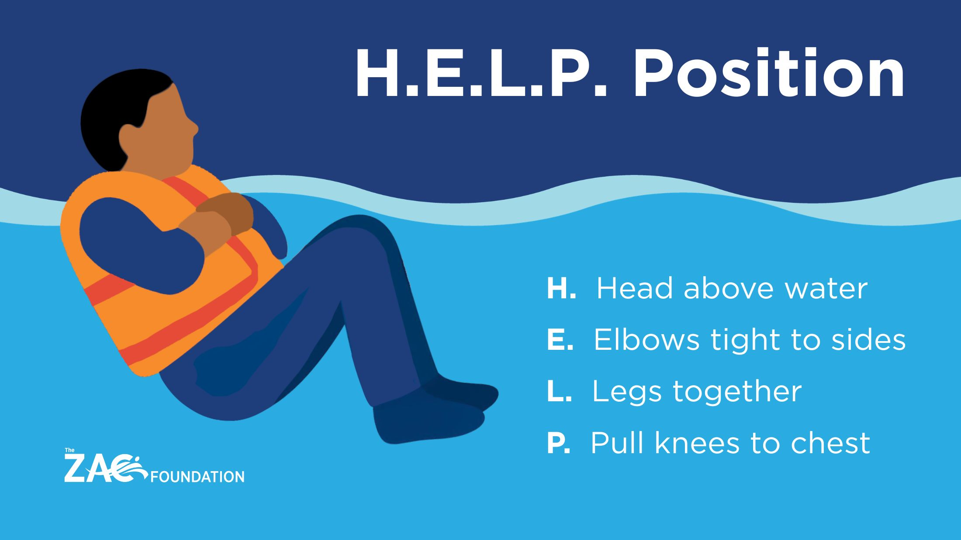
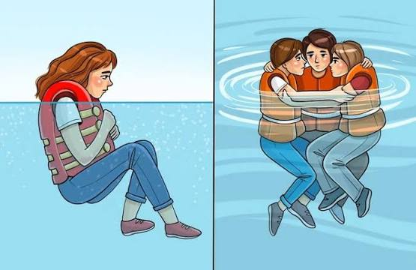
HELP Position and Huddle
Notes:
A HELP Huddle (Heat Escape Lessening Posture Huddle) is a water survival technique used by a group of people wearing life jackets in cold water.
Survivors float closely together with chests pressed together, arms wrapped around each other's backs, and legs intertwined to conserve body heat.
The "HELP" part of the term refers to the individual Heat Escape Lessening Posture, where a single person draws their knees to their chest and hugs their arms inward to protect high heat-loss areas like the armpits, rib cage, and groin.
When performed as a group huddle, it offers several critical survival advantages:-
Thermal Conservation: Sharing body heat slows down the onset of hypothermia.
Increased Visibility: A tight cluster of people is much easier for search and rescue teams to spot than scattered individuals.
Morale Support: Group interaction and communication reduce panic and fear in emergency situations.
To perform this effectively, rescuers and safety experts recommend that any children or weaker swimmers be placed in the very centre of the huddle to keep them warm and secure.

Slide 20
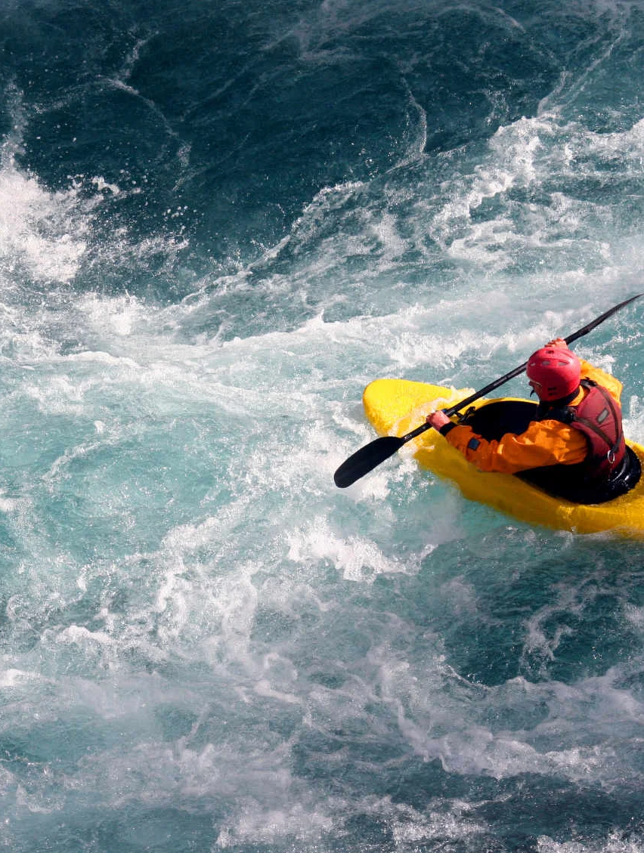
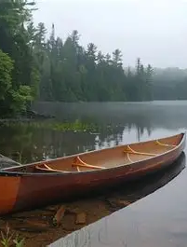
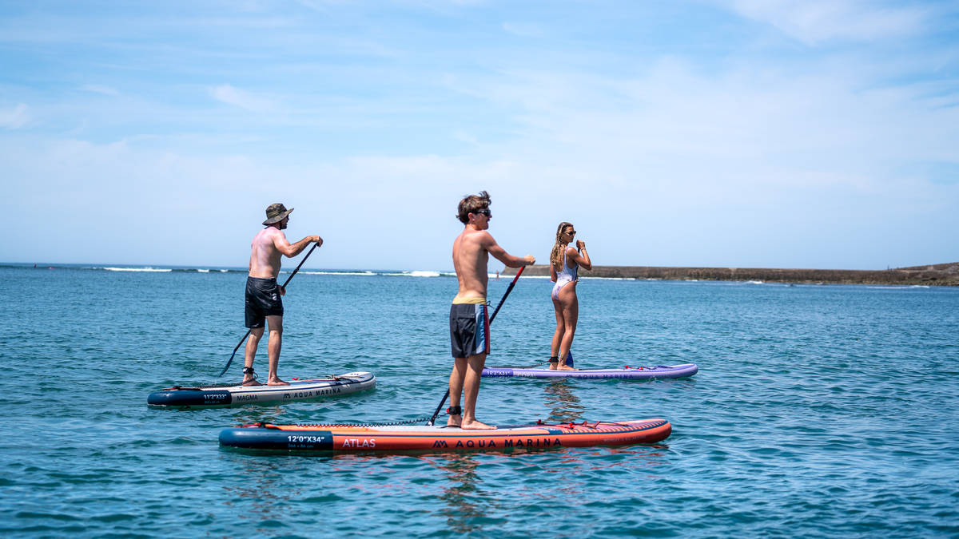
Kayaks, Canoes & SUP’s
Notes:
(General discussion re safety for each craft)
Show:
how paddlers stay safe, look after self and others
group paddling
buoyancy aids
whistles
rafting up and group safety
use of leashes
Emphasise current unacceptable demand on rescue services by irresponsible SUP users

Slide 21
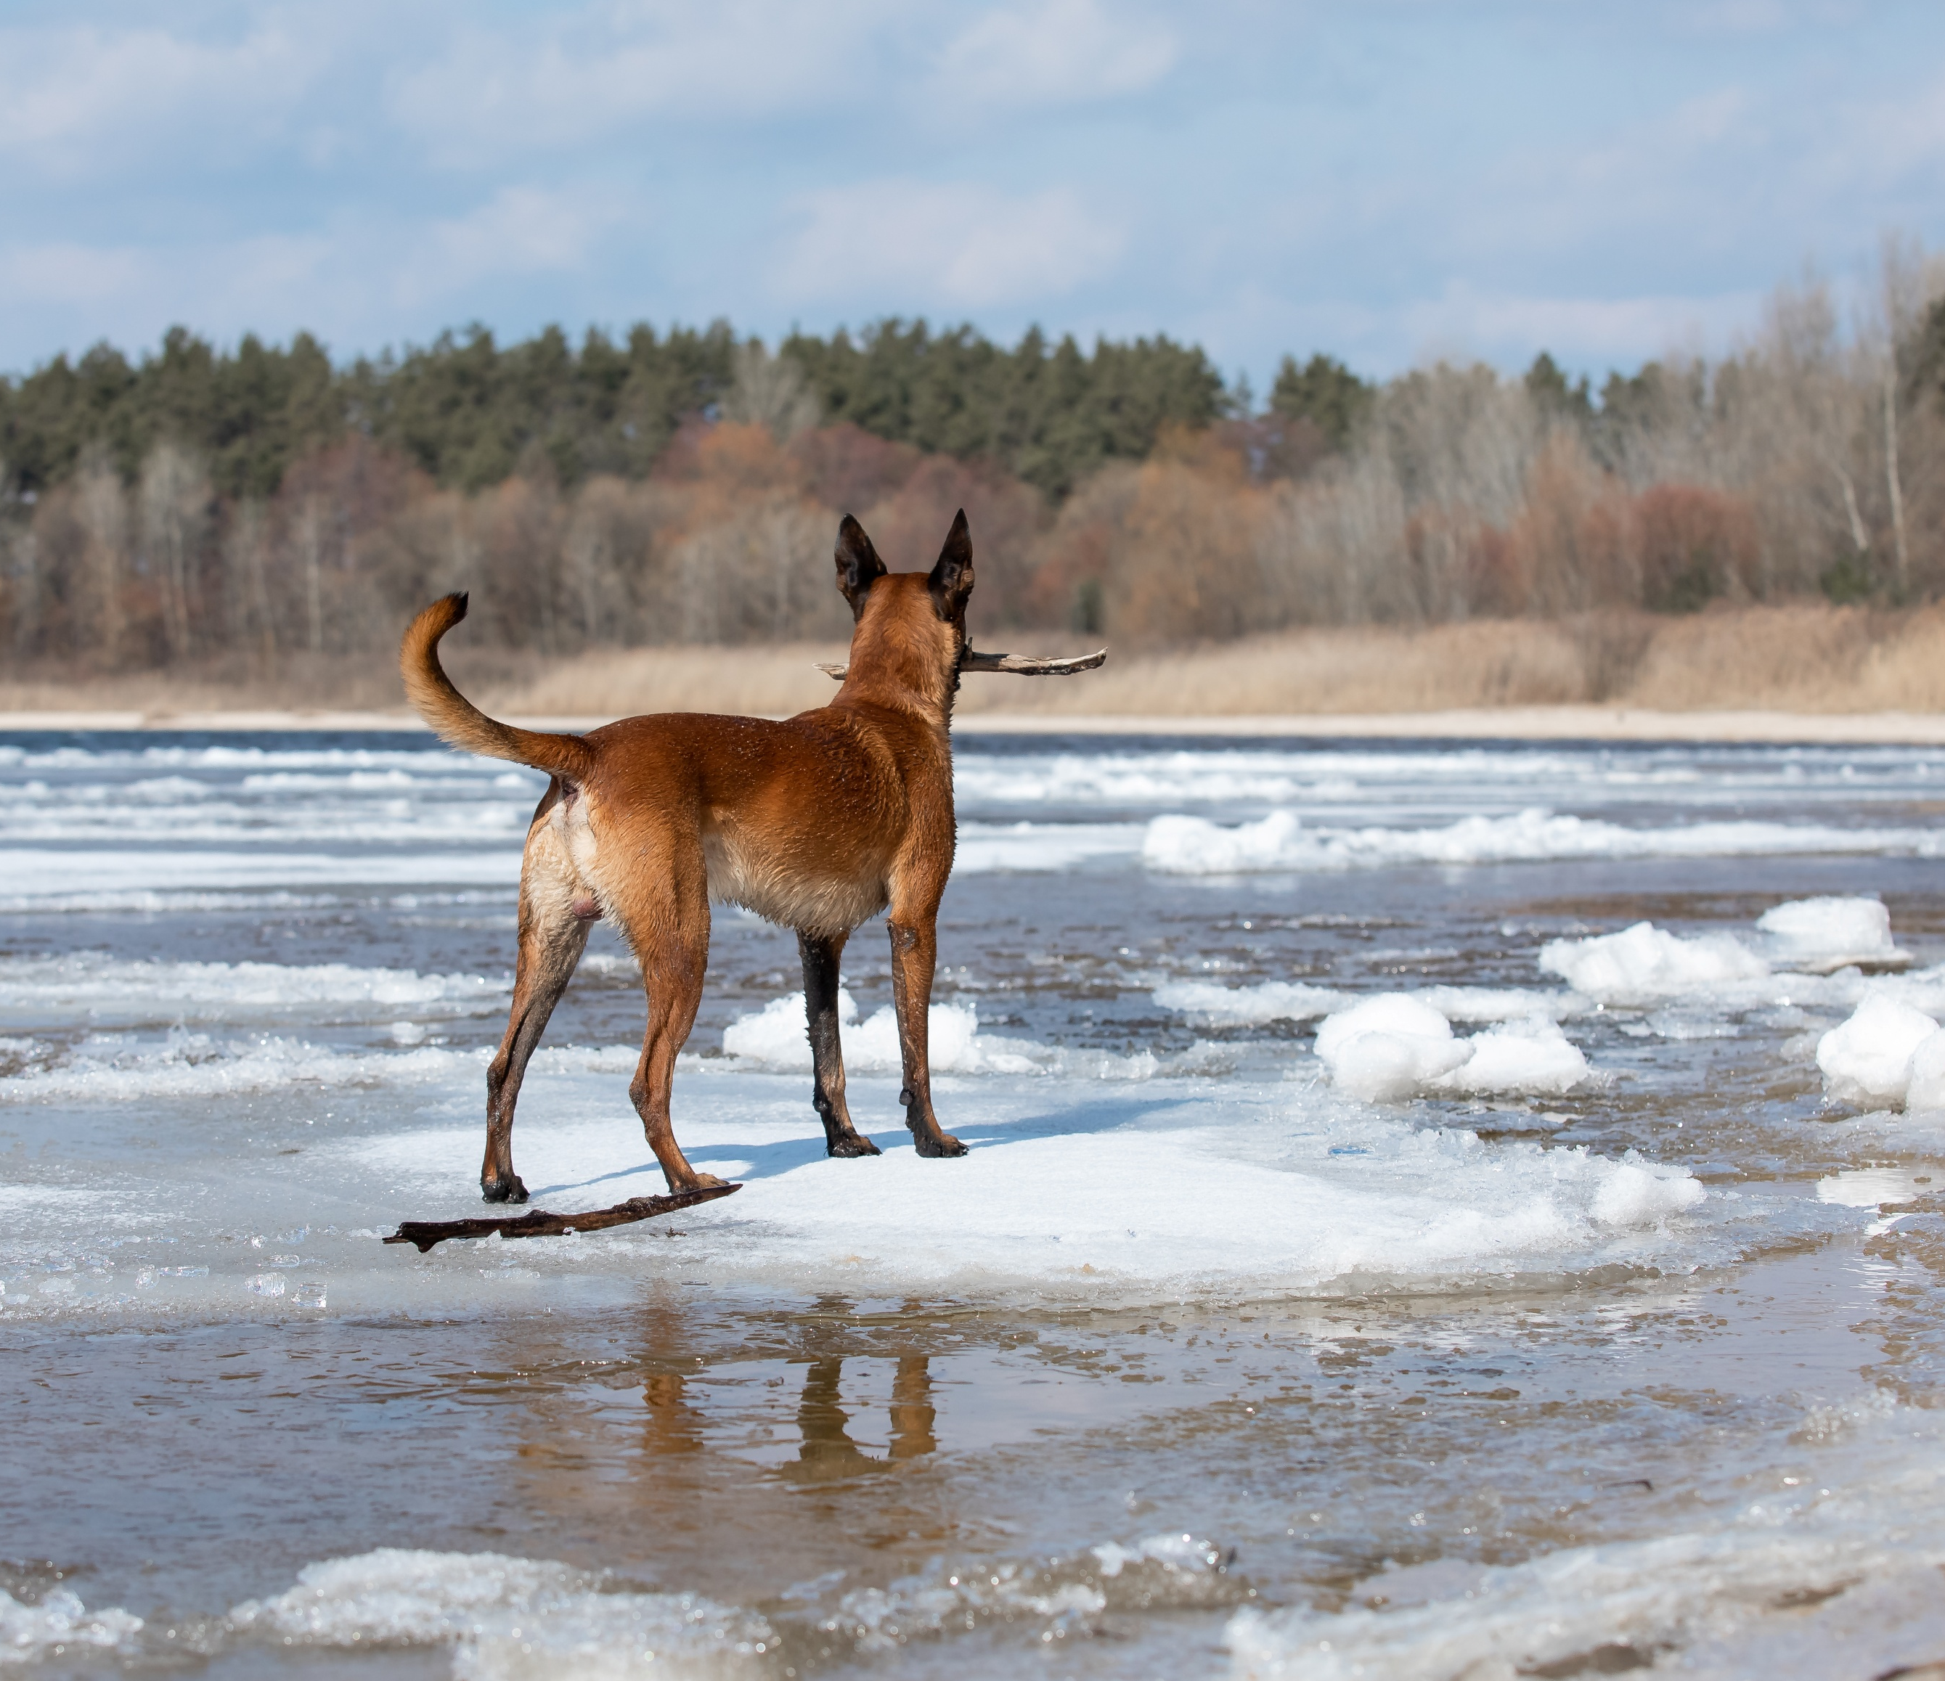
Winter Safety
Notes:
(General discussion re winter safety and not rescuing pets/animals)
Notes:
Never assume frozen water is 100% safe, as ice thickness changes rapidly due to hidden currents, underwater structures, and temperature shifts. Organizations like the Royal Life Saving Society UK (RLSS UK) and the Royal Society for the Prevention of Accidents (RoSPA) urge the public to prioritize caution and stay off the ice unless it is officially monitored and tested.
Reading the Ice Conditions
Study the colour: Clear blue or black ice is the dense and strong. White, opaque, or snow-packed ice is only half as strong. Grey or dark ice indicates rotting, melting, and active danger zones.
Avoid flowing water: Rivers and streams are inherently much more dangerous than lakes. Moving currents erode the ice from underneath, making surface appearances highly deceptive.
Watch the boundaries: Stay away from areas near bridges, docks, half-submerged logs, and plants. These structures absorb heat and create weak surrounding patches.
Preparation & Gear in the unlikely event of needing to go onto ice
Wear a PFD: Always wear a personal flotation device or a thermal survival suit.
Carry ice picks: Keep a pair of handheld ice claws or picks accessible around your neck to pull yourself out during an emergency.
Pack a safety rope: Bring a 50-foot throw line to assist others.
Share your plan: Never go out alone; always let someone on shore know your timeline.
Emergency Response Protocols
If You Fall Through the Ice (The 1-10-1 Rule)
1 Minute to control breathing: Do not panic. Keep your head up and focus on steady breathing to overcome initial cold-water shock.
10 Minutes for self-rescue: Move back toward the direction you came from, as that ice previously held your weight.
Kick and slide: Place your hands flat on the ice, kick your legs horizontally behind you to get your body flat, and crawl forward like a seal onto the shelf.
Roll away: Do not stand up immediately. Roll or slide across the surface to distribute your body weight until you reach stable ground.
1 Hour of consciousness: If you cannot climb out, conserve heat by pulling your knees to your chest, keeping your arms close, and waiting for rescue.
If You See Someone Else Fall In
Reach, Throw, Don't Go: Never run onto the cracking ice to help, or you will become a second casualty.
Call for help and call emergency services immediately.
Extend your reach: Lie down flat on the safe bank and extend a tree branch, jumper, or rope.
Keep pets secure: Keep dogs on a leash near frozen water. If a pet falls through, do not go after them; they are often capable of pulling themselves out, whereas humans easily succumb to cold shock.

Slide 22
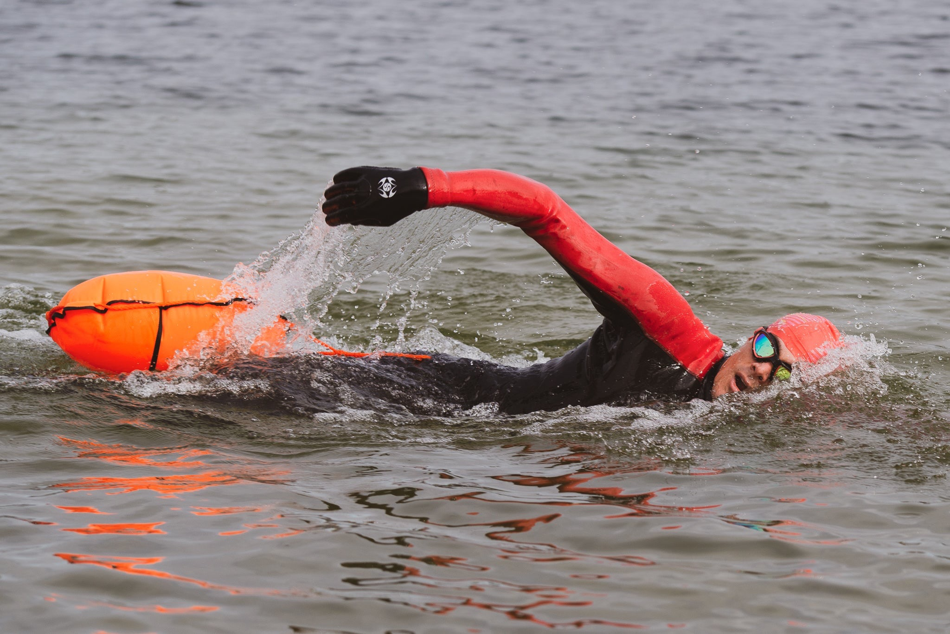
If you are going to swim;
-Choose your spot
-Have right equipment
-Weather and tides?
-Acclimatization
-Float to live
-Case of emergency
Notes:
Excellent advice on the RNLI website
https://rnli.org/safety/choose-your-activity/open-water-swimming
Before you go
Going for a swim in cold, open water can be exhilarating, but it’s not without risk. If it’s your first time open water swimming or coldwater dipping, it’s important to speak to a health care professional to discuss the risks of coldwater immersion before you go.
Always arrange to go with a buddy. Sea swimming is much more fun with someone else, and you can look out for each other. It’s also good to tell someone on shore where you are going and when you will be back. They’ll be able to call for help if you are overdue back.
Choose your spot
When open water swimming at the coast, it’s best to choose a lifeguarded beach and swim between the red and yellow flags.
If there is no lifeguard cover, make sure you know:
where you can enter and exit the water
your location – are there any hazards you need to be aware of?
what the tide and currents are doing - check the tide times before entering the water
how to spot rip currents
what to do if you get caught in a rip current. Don’t try to swim against it. If you can stand, try to wade rather than swim. Next, swim parallel to the shore until free of the rip and then head for shore. Raise your hand and shout for help.
Make sure you always take a means of calling for help with you
Have the right equipment
Wear a wetsuit. It’ll help you stay warm and can increase your buoyancy, so you can stay in the water for longer.
Wear a brightly coloured swimming hat and take a tow float with you when sea swimming or dipping. These will help you to be seen in the water and a tow float can act as extra buoyancy if you need it.
Always take a means of calling for help with you, such as a mobile phone in a waterproof pouch and a whistle to attract attention. You might like to download the RYA SafeTrx app (UK) or Irish Sailing SafeTrx app (Ireland), which can track your swim and alert emergency contacts if you fail to return home on time.
Make sure you have plenty of warm clothes and a warm drink for after your swim. It is important to warm yourself up carefully.
Check the weather and tides
Always check the weather forecast and conditions before you swim in the sea. If you’re planning to be out for a long time, get regular updates. And be prepared to change your plans or cancel the trip if the forecast is not safe. If in doubt, don’t go out.
Check the weather. Check Met Office (UK) or Met Éireann(Ireland) for an inshore waters forecast.
Check the tides. Find tide tables and surf reports for the UK on the Met Office or Admiralty EasyTide.
Acclimatisation
Before you enter the water, assess the conditions. If the water is too rough for swimming, don’t get in. Know your limits – depending on the conditions, you may need to swim less or closer to the bank or shore. The temperature of the air and water is also important – the colder the water and air temperature, the quicker you will cool down. So the colder it is, the less time you should spend in the water.
When you go open water swimming, it’s very important to enter the water slowly and allow time for your body to get used to the cold. Never jump or dive straight in, as this could cause cold water shock.
To help yourself acclimatise, splash the cold water on your neck and face. Try not to hold your breath for an extended time when you first get into the water.
Once you are in the water, remember that cold water immersion can seriously affect your swimming ability. Stay within your depths and swim parallel to the shore. The wind can push you off course when open water swimming, keep an eye on your exit point and make sure you can return to it.
Float to Live
If you're swimming in the sea or open water, make sure you know how to float.
Entering water under 15°C can seriously impact your ability to breathe and move. If you get into the water too quickly or fall in unexpectedly, you may experience cold water shock. If this happens, fight your instinct to swim. Turn onto your back and tilt your head back in the water, submerging your ears. Relax and try to breathe normally, using your hands to helps you stay afloat. Wait until the shock passes then call for help or swim to safety.
When open water swimming, you might get tired. Roll on to your back to rest and hold on to something that floats, like your tow float. Then you can signal for help if needed.
In case of an emergency
In case of an emergency, call 999 or 112 and ask for the coastguard.
You should always carry a means of calling for help when sea swimming or cold water dipping. This could be a mobile phone in a waterproof pouch. Remember, if you don’t have any mobile phone signal, don’t panic. You can still try calling 999 or 112, even if your own mobile phone network has no coverage. Your phone will try to connect to any other network available.
You might also like to consider downloading the RYA SafeTrx App (UK) or Irish Sailing SafeTrx (Ireland) app. It can track your swim and alert emergency contacts if you fail to return home on time.

Slide 23

Notes:
Lonely Water (widely known as The Spirit of Dark and Lonely Water) is a 1973 British Public Information short film Voiced By Donald Pleasence.
https://www.youtube.com/watch?v=XNPMYRlvySY

Slide 24
Royal Life Saving Society Safety Tips
Notes:
The RLSS are the UK experts on swimming in open water safety. They have an excellent website full of useful advice. WWW.rlss.org.uk
Notes
In the last 5 years, 90% of accidental drownings occurred at open water sites, either inland or on the coast. Many of these drownings occur due to a lack of knowledge and understanding of open water safety.
The basic principles of open water safety, combined with knowledge and understanding of the hazards, can increase the enjoyment of open water and significantly reduce the number of incidents that occur each year.
The benefits of swimming and dipping in open water are well documented. Not only does being in or on open water allow new adventure it also has documented benefits for both physical and mental wellbeing. All these hazards can be controlled through proper organisation and planning.
Risks to consider in open water include:
The shock of cold water can make swimming difficult and increase the difficulty in getting out of the water
Lack of safety equipment and increased difficulty for rescue
The height of the fall or jump if tombstoning
The depth of the water – this changes and is unpredictable
Underwater objects and hazards may not be visible
Obstacles or other people in the water
Strong currents can rapidly sweep people away
Uneven banks and riverbeds
Water quality, e.g. toxic algal blooms and industrial/agricultural pollution
Ahead of the school summer holidays, people are being reminded of the risks of open water swimming to prevent serious injury or loss of life.
Experts from the Extreme Environments Laboratory (EEL) at the University of Portsmouth have supported RLSS UK in providing advice and guidance for anyone wanting to take a dip outdoors.
According to RLSS UK's National Drowning Report 2023, there is a relationship between warmer weather and an increase in fatal drowning incidents. 46 per cent of drownings occur in the summer months of which and this rises to 75 per cent are aged between amongst 13 to 17 years old.
In the past five years, nearly a quarter of all accidental drownings have occurred when swimming at open water sites, either inland or along the coast (WAID UK, 2022). Many of these lives could have been saved with some basic knowledge and understanding of open water safety.
Recommendations include:
Plan your swim
Have the right equipment
Know your limits
How to stay safe and get help
Recognise when you’re too cold
Know how to help someone in the water and in difficulty
Know when not to go!

Slide 25
Drowning is preventable therefore water safety education is vital
September 2026 will be part of RHSE guidance in schools
Notes:
New water safety curriculum changes coming this September.
From September, the Water Safety Code will be included in the updated RSHE statutory guidance for schools in England, making water safety education a mandatory part of the Health and Wellbeing: Personal Safety curriculum requirements.
Now is the time to get prepared. By embedding these life-saving skills into your teaching, you can help pupils build the knowledge and confidence to stay safe in, on, and around water.
We’re here to support you with ready-to-use resources designed for primary, secondary, and SEND settings.
✅ Get ahead and start planning now
✅ Access free tools to support delivery
✅ Help equip young people with vital life-saving knowledge
Explore school resources and get started: www.rlss.org.uk/water-safety-education
Explore Water Safety Code downloads: www.rlss.org.uk/water-safety-code-downloads

Slide 26
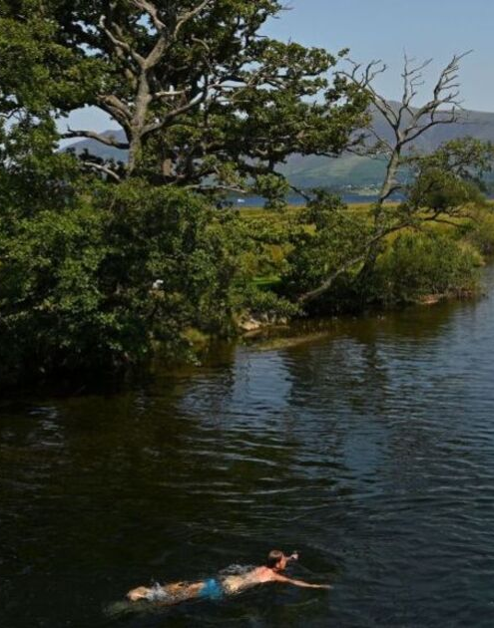
Health Factors
Open Water Health Risks
Open water swimming can be enjoyable but carries risks
Water may contain harmful bacteria and parasites
Possible illnesses:
Stomach bugs (diarrhoea, vomiting)
Skin, ear, eye & respiratory infections
Usually mild, but can be serious:
E. coli – severe illness
Leptospirosis (Weil’s disease) – can affect liver & kidneys
Notes:
Emphasise that while most cases are mild, the risk is real especially in untreated water like rivers, docks, and flood channels common in Hull. Keep the tone informative, not alarming.
https://www.gov.uk/government/publications/swim-healthy-leaflet/swim-healthy?utm_source=Facebook&utm_medium=social&utm_campaign=Orlo&utm_content=Heatwave
Health risks
Anyone can become unwell from swimming in any open water as there will always be micro-organisms present. The risk of becoming ill depends on various factors:
-children and novice swimmers are more likely to swallow water accidentally
-those with an impaired immune system are more susceptible to infection
-those swimming in rivers and estuaries are more likely to become unwell
-heavy rainfall can wash harmful bacteria from agricultural land, urban areas and sewage to rivers, seas and bathing waters and affect water quality
Reducing the risk of getting ill
There are several things you can do to reduce the risk of illness when swimming in open waters.
Choose where and when to swim
Up to date bathing water quality information is available online during the bathing season between May and September. Other considerations to help you choose where to go include:
- checking the water quality information for over 400 designated bathing waters in England
- avoiding bathing on higher risk days, by checking the pollution risk forecast, or look for signs at the beach
Before you swim
There are several things you should consider including:
choosing the location carefully and avoid swimming in water with blue-green algal blooms or scums in freshwaters
covering cuts, scratches or sores with a waterproof plaster before swimming
- wearing appropriate protective clothing such as a wetsuit, gloves or protective footwear
While you are swimming
Remember to:
avoid stream water running across the beach
- try to avoid swallowing or splashing water into your mouth
- observe local safety advice
After swimming
Following the swim, you can minimise the risk of becoming ill by:
- cleaning your hands thoroughly with soap and water ensuring that all wet sand is removed from hands before eating or handling food
-thoroughly cleaning cuts or abrasions using soap and water
-handle your wetsuit with care after use. Rinse it with clean water as soon as is practicable after swimming. Clean with detergent and rinse as advised by the manufacturer. Always wash your hands with soap and water after handling or cleaning your wetsuit. Allow the suit to dry thoroughly before reuse.
What to do if you become unwell
If you do become unwell with diarrhoea or any other symptoms, seek medical help and let them know you have been open water swimming. Do not swim again until you have had no diarrhoeal symptoms for at least 48 hours, or for a longer period if advised by a doctor.
Information on bathing water and beach risks
GOV.UK bathing waters collection of information
GOV.UK quality of local bathing water information
Surfers Against Sewage provide the Safer Seas Service app. which uses open data from across the UK and water company updates to provide real-time water quality alerts for over 350 locations in the UK

Slide 27
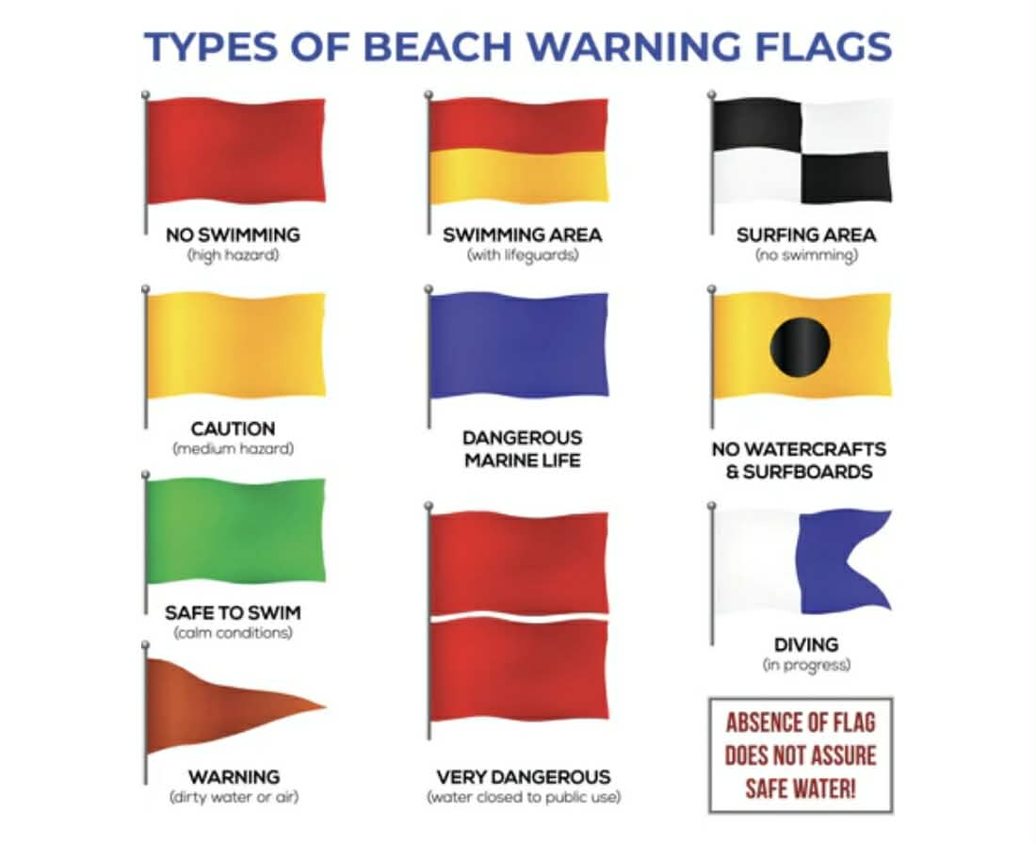
Notes:
Other resources

Slide 28
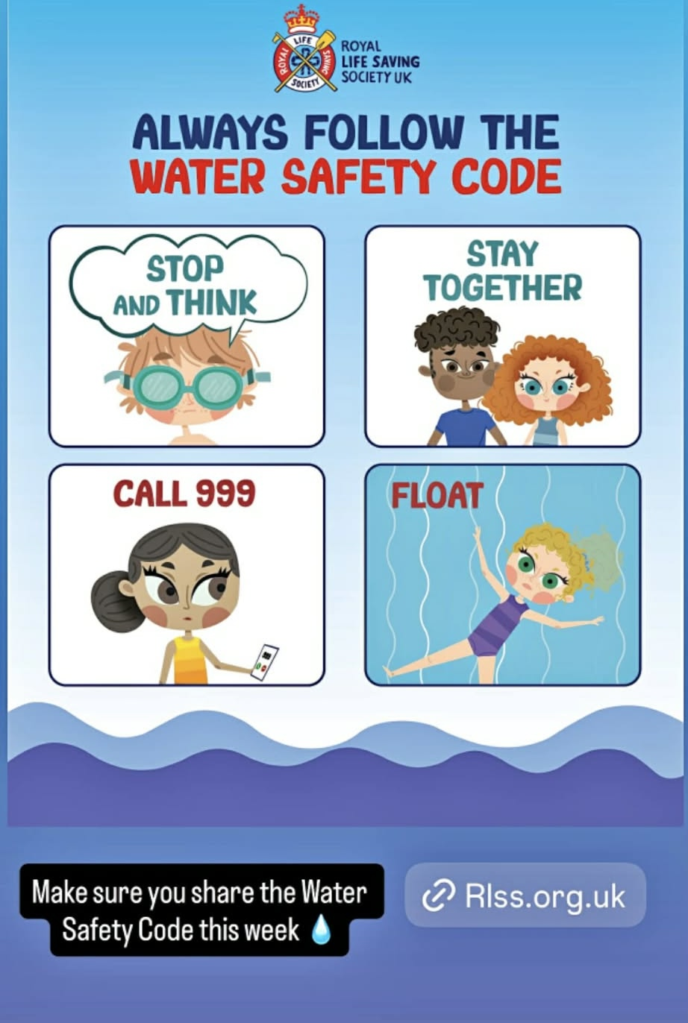
Notes:
Other resources

Slide 29

Tips for parents 1 – Bright swimwear
Notes:
Notes
Before you buy your kids' swimsuits for the season, think about visibility.
Drowning is the leading cause of death for children ages 1–4 in the U.S.A. (Source: Centres for Disease Control and Prevention).
Because water emergencies happen fast and silently, your eyes need to be able to lock onto your child instantly.
❌ Skip these: Blues, greens, whites, and dark neutrals. They mimic water reflection or look like shadows/debris at the bottom.
✅ Buy these: Neon orange, neon pink, neon yellow, and bright red. Testing shows these maintain the highest visibility under water and through splashes.
Swimsuit colour isn't a substitute for designated water watchers and swim lessons—but it is a simple, lifesaving layer of protection.
Thanks CDC US Swim School Association

Slide 30
Tips for parents 2 – Infant advice
Notes:
USA organization infantswim.com have lots of sensible resources and videos to help parents keep infants and toddlers safe

Slide 31
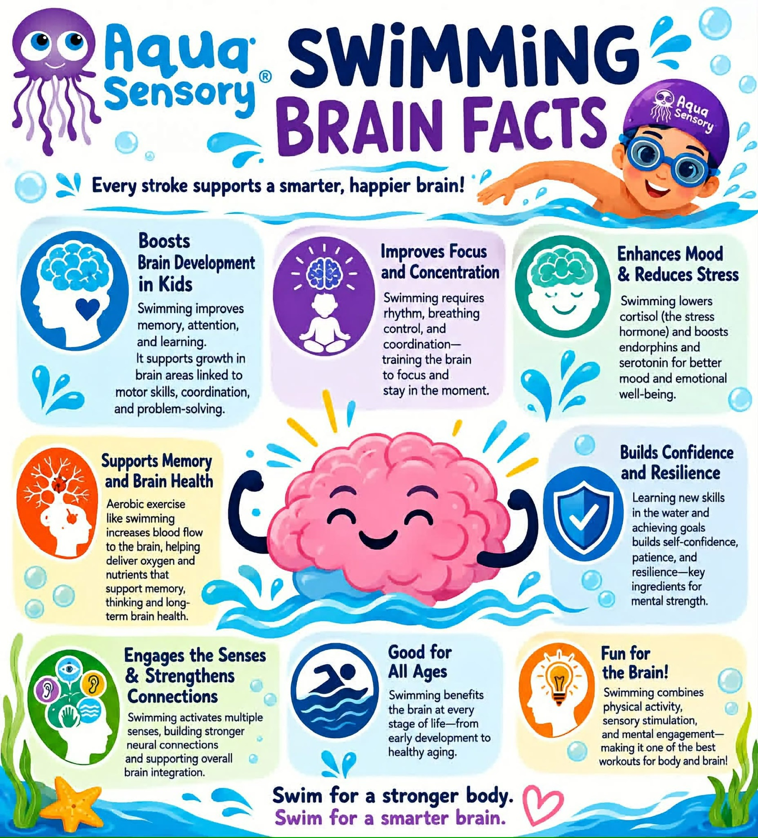
Tips for parents 3 – Brain Benefits
Notes:
Sadly statistics show that the majority of Year 6 children (10 to 11 years) cannot swim
Only 25% of children leaving primary school can swim (source Swim England)

Slide 32
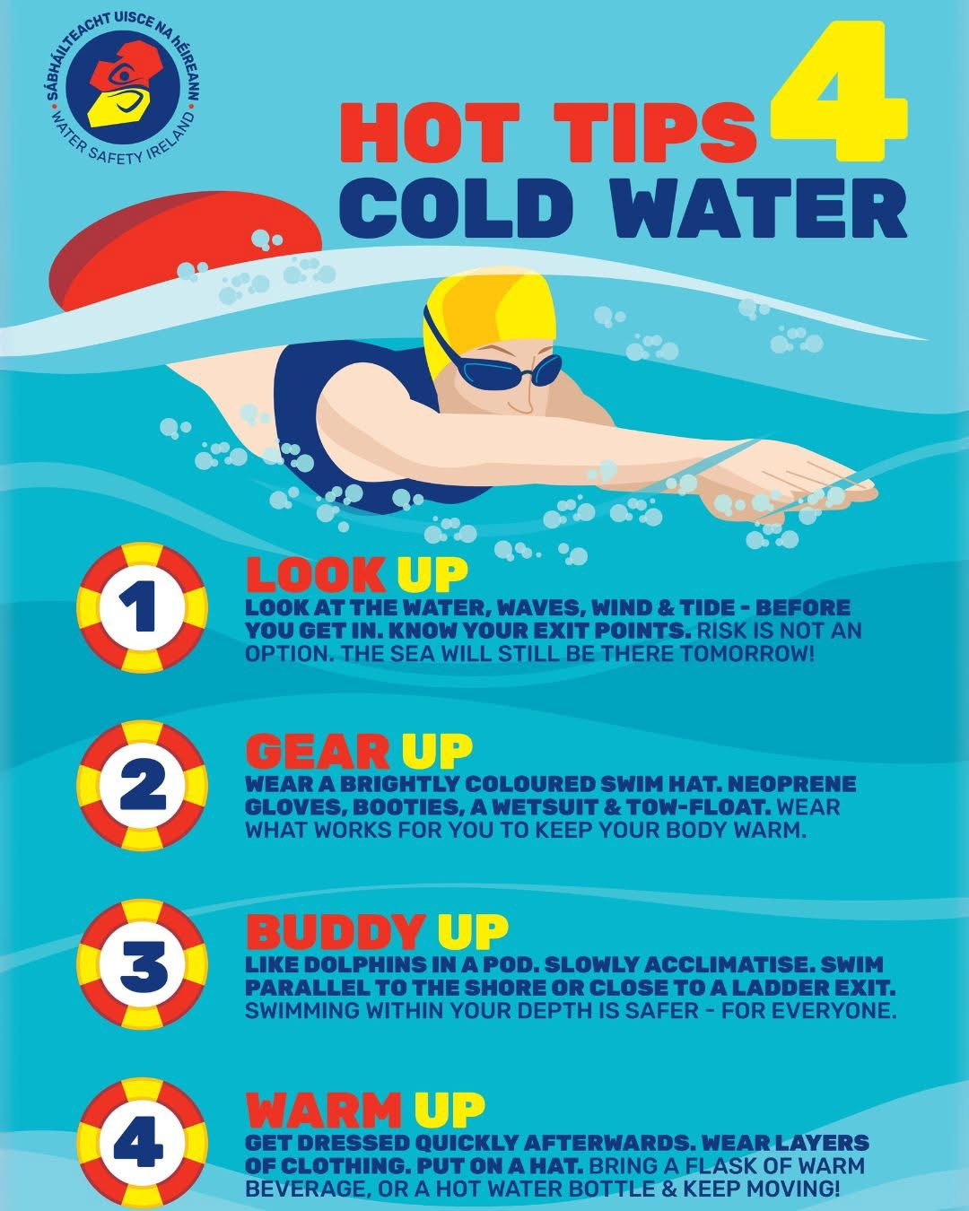
Tips for parents 4 – Hot tips cold water

Slide 33
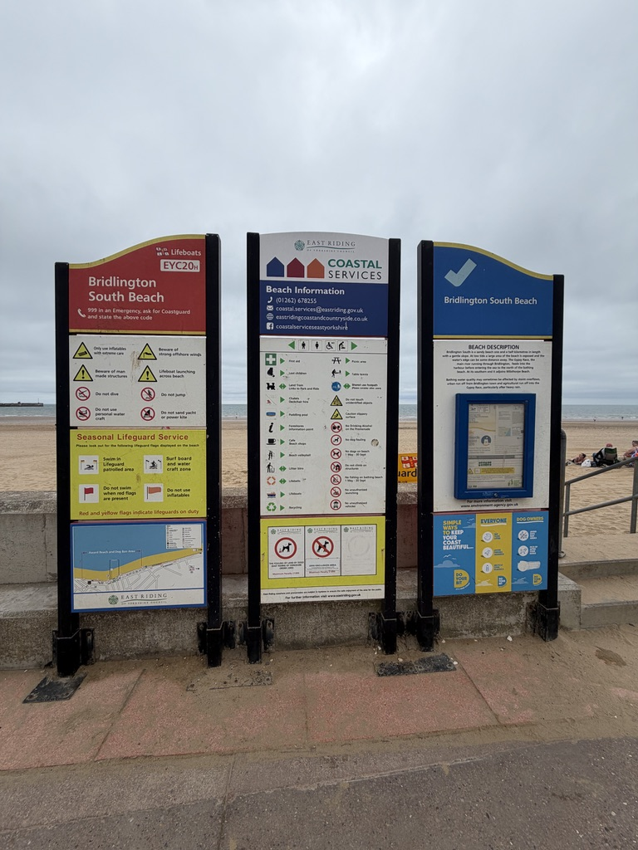
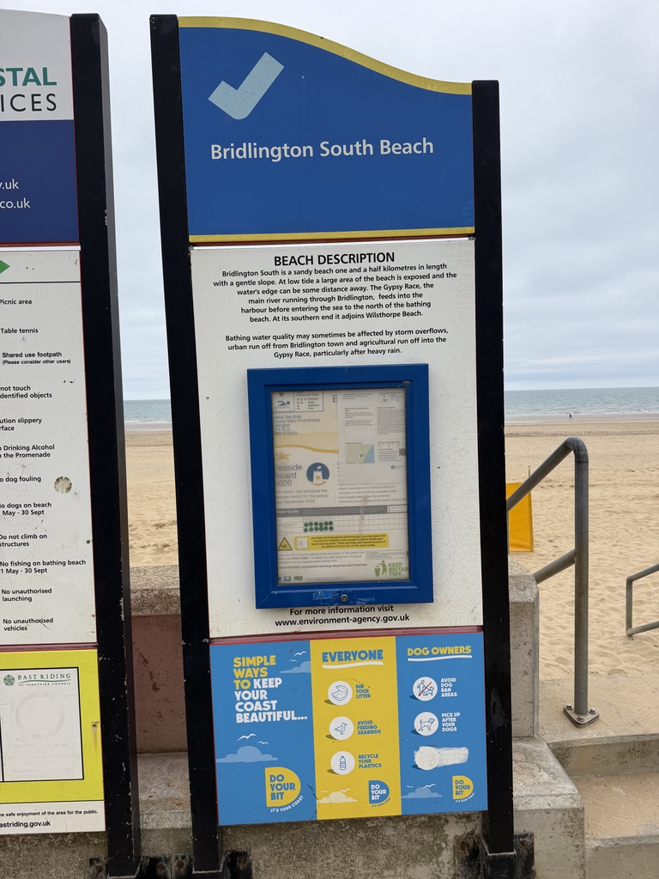
Tips for parents 5 – Local information
Notes:
Excellent signage at Bridlington
Read the information if its not readily available search WWW

Slide 34
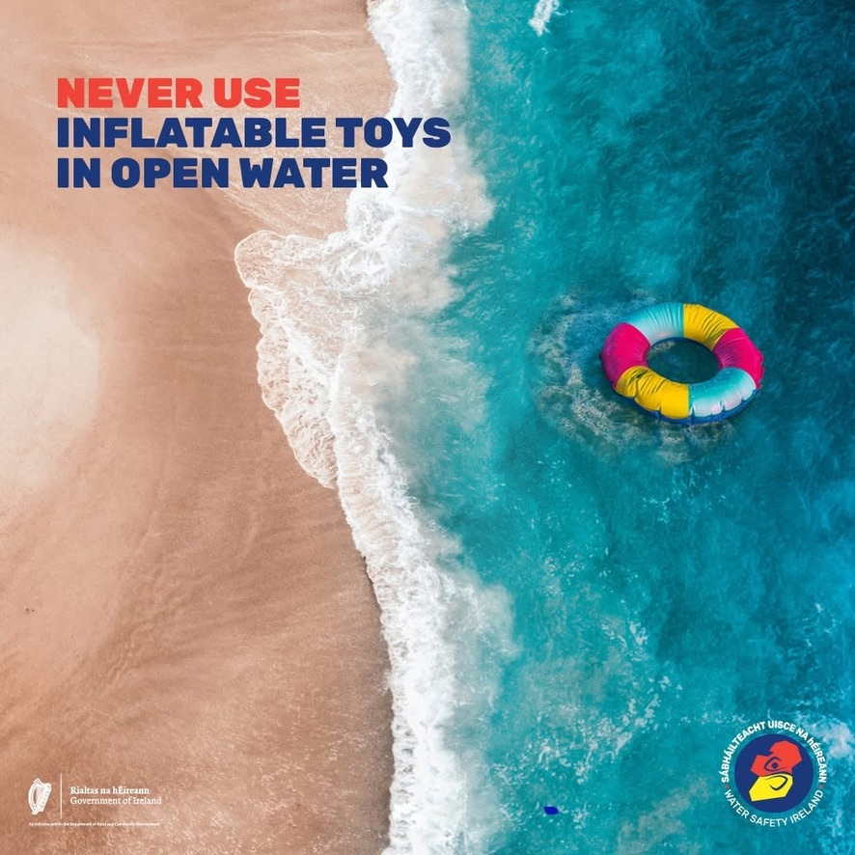
Tips for parents 6 – Inflatable caution
Notes:
Inflatable toys, lilos, and air mattresses are for the pool not open water. Even on calm days, winds and currents can quickly carry you away from shore. Stay safe and leave inflatable toys on dry land when heading to the beach.

Slide 35
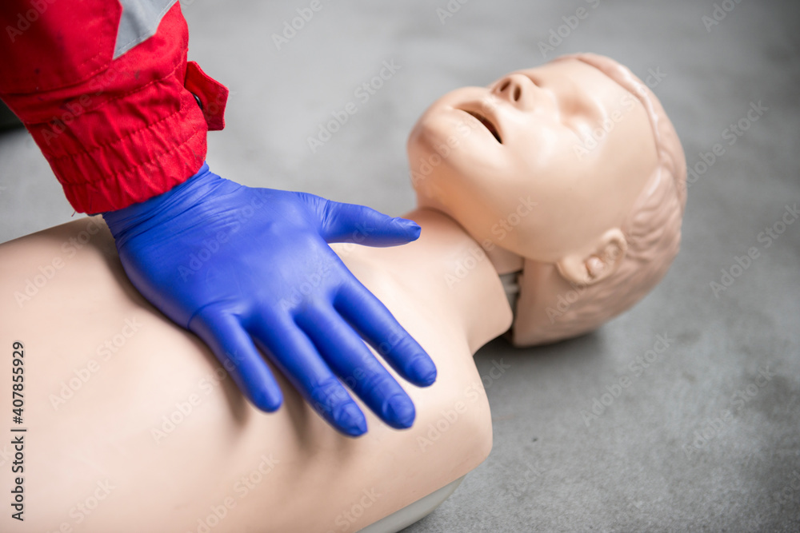
Tips for parents 7 – CPR
Notes:
Key Steps for Children (Aged 1 to 12)
Check the Scene: Ensure it is safe before approaching.
Assess Responsiveness: Gently shake the child's shoulders and ask loudly, "Are you alright?"
Open the Airway: Place one hand on the forehead, gently tilt the head back, and lift the chin. Look, listen, and feel for normal breathing for no more than 10 seconds.
Give Rescue Breaths: If they are not breathing normally, pinch the nose and make a seal with your mouth over theirs. Give 5 initial breaths.
Chest Compressions: Place the heel of one hand in the centre of the chest. Push down by about one-third of the chest's depth (approx. 5 cm or 2 inches).
Cycle: Perform 30 chest compressions, followed by 2 rescue breaths. Repeat this cycle.
Key Steps for Infants (Under 12 months)
Airway: Tilt the head back very slightly to a neutral position.
Breaths: Cover both the infant's mouth and nose with your mouth and use gentle puffs of air instead of a forceful blow.
Compressions: Use two fingers in the centre of the chest for a single rescuer. If another rescuer is present, use the two thumb-encircling hands technique. Press down about 4 cm (1.5 inches).
Essential Tips
Call 999: Call emergency services and put the phone on speaker immediately. If you are alone with an unresponsive child, perform 1 minute of CPR before calling.
Remove Obstructions: Look in the mouth and remove any visible blockages before giving breaths.
Follow Training: For localized, official guidance, review the paediatric protocols detailed by the Resuscitation Council UK or the British Heart Foundation.

Slide 36
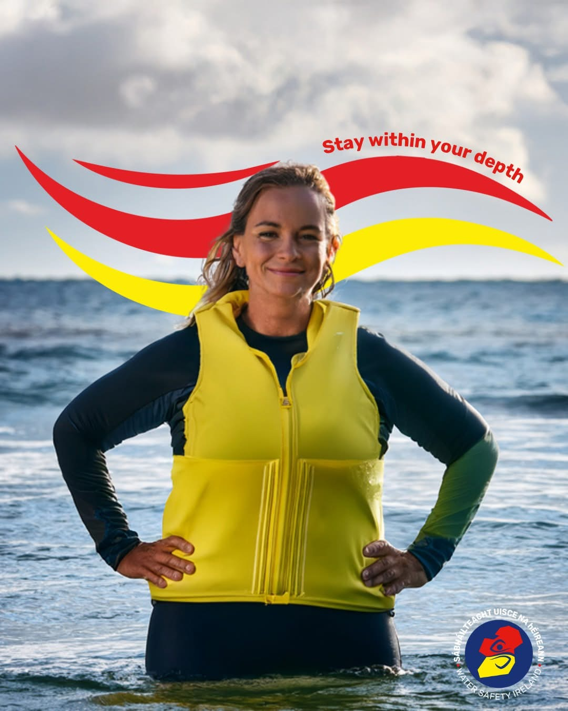
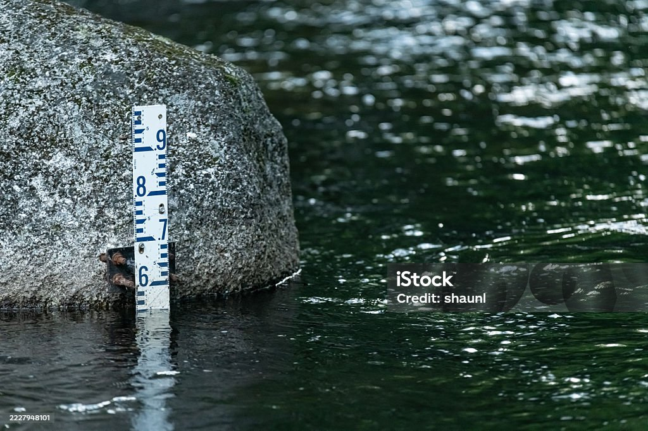
Tips for parents 8 – Depth
Notes:
Stay within your depth and enter the water slowly and safely, sudden drop‑offs and cold shock can catch anyone out.
Know your limits and protect yourself.
For more water safety advice head to www.watersafety.ie

Slide 37

Tips for parents 9 – Save Little Lives
Notes:
A child who enjoys the water will usually make more progress than a child who feels pressured in it.
That’s why “just put your face in” often doesn’t work.
But “Can you make bubbles like a whale?”
“Can you catch the treasure?”
“Can you float like a starfish?”
That feels different. Same skill.
Completely different experience.
A US website with huge range of useful ideas and advice for parents.
https://judahbrownproject.org
This 4th of July weekend, Harris County (Houston area) saw 3 child drownings.
A five-year-old was in a pool full of people and drowned anyway. His mom and Aunt were on the other side of the pool when someone found him, unresponsive in the water. He later died.
An 8-year-old was found in a pool and is currently at the hospital. No further details are known at this time.
A 2-year-old and a 72-year-old were both found in a small pond with a walking path around it, in a neighborhood in Cypress. It’s the type of pond that is commonly found in neighborhoods across the city of Houston. Both died.
Friends, July sees more drownings every year in the USA than any other month.
These stories are the same ones that happen over and over again.
Yes, a child can drown in a crowded pool with lots of people around. When the pool is busy, all of the noise and activity hijacks attention away from a person who is drowning, because drownings are quiet and quick. Our brains are wired to give the most attention to the loudest, brightest, and fastest-moving things. Drowning is none of those things. Because of this, they are easy to miss. We just don't see them.
This is why you need to be close enough to your child at all times in and around water that you could reach your arm out and grab them if you needed to. This is why your child needs to know how to float on their back and wait for help. This is why you don’t rely on a lifeguard or friends or family to know where your child is. It is far too common that when everyone is supposed to be watching, no one is actually watching because everyone assumes someone else is doing it.
And yes, kids can drown in those ponds that back up to your backyard. If they do, it is even more dangerous than a pool, as you cannot see someone as clearly in natural water as you can in a pool.
This is why barriers are a must. Fences, locks, and alarms all help prevent a child from getting to that water. This is again why your child needs to know how to float on their back and wait for help if they do get into the water alone.
Drowning is fast, silent, and common, and we in the USA are in the worst month for it all year. If you haven’t been thinking about water safety before, you NEED to NOW!

Slide 38

Tips for parents 10 – STA One Stop Shop
https://www.youtube.com/watch?v=NOO1tfwgj-s
Notes:
In the UK the Swimming Teachers Association has a huge amount of useful resources
This video contains the main messages of the rest of this presentation
https://www.youtube.com/watch?v=NOO1tfwgj-s

Slide 39
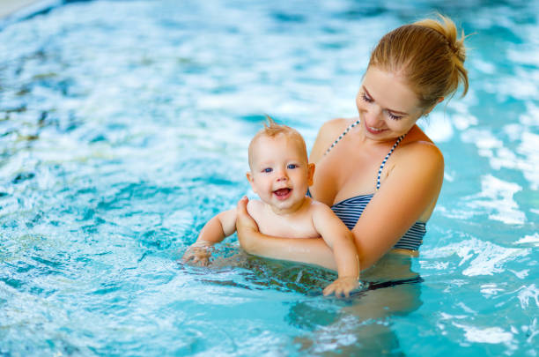
Tips for parents 11 – You're not a teacher
Simple games that build confidence, water skills & trust
Notes:
Parents: your child does not need you to be a swimming teacher.
They need you to know what to do in the pool.
That’s the difference.
You don’t need complicated drills.
You don’t need expensive equipment.
You don’t need to turn it into a formal lesson.
You just need simple games that build confidence, water skills and trust.

Slide 40
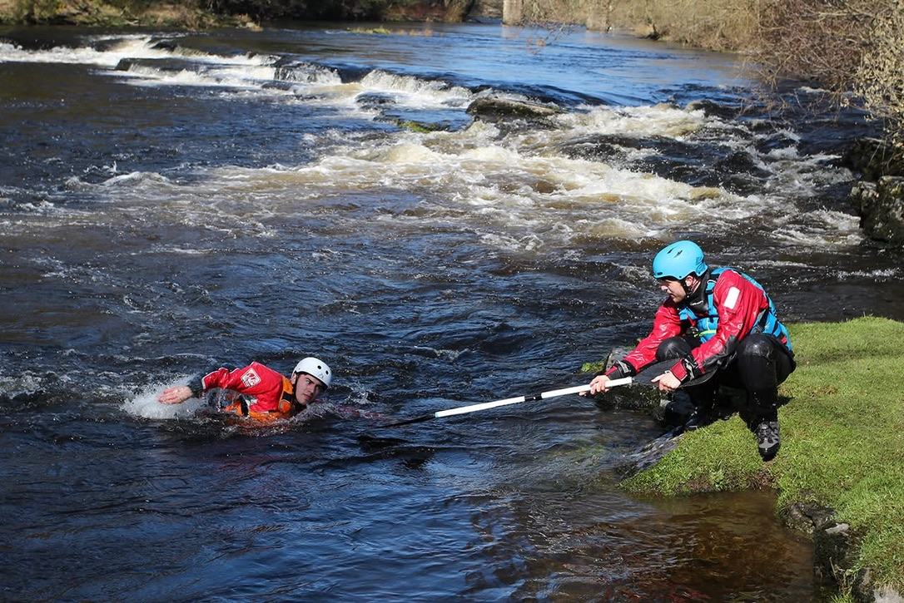
Notes:
Real life rescue
Notice use of a pole and low body centre of gravity

Slide 41
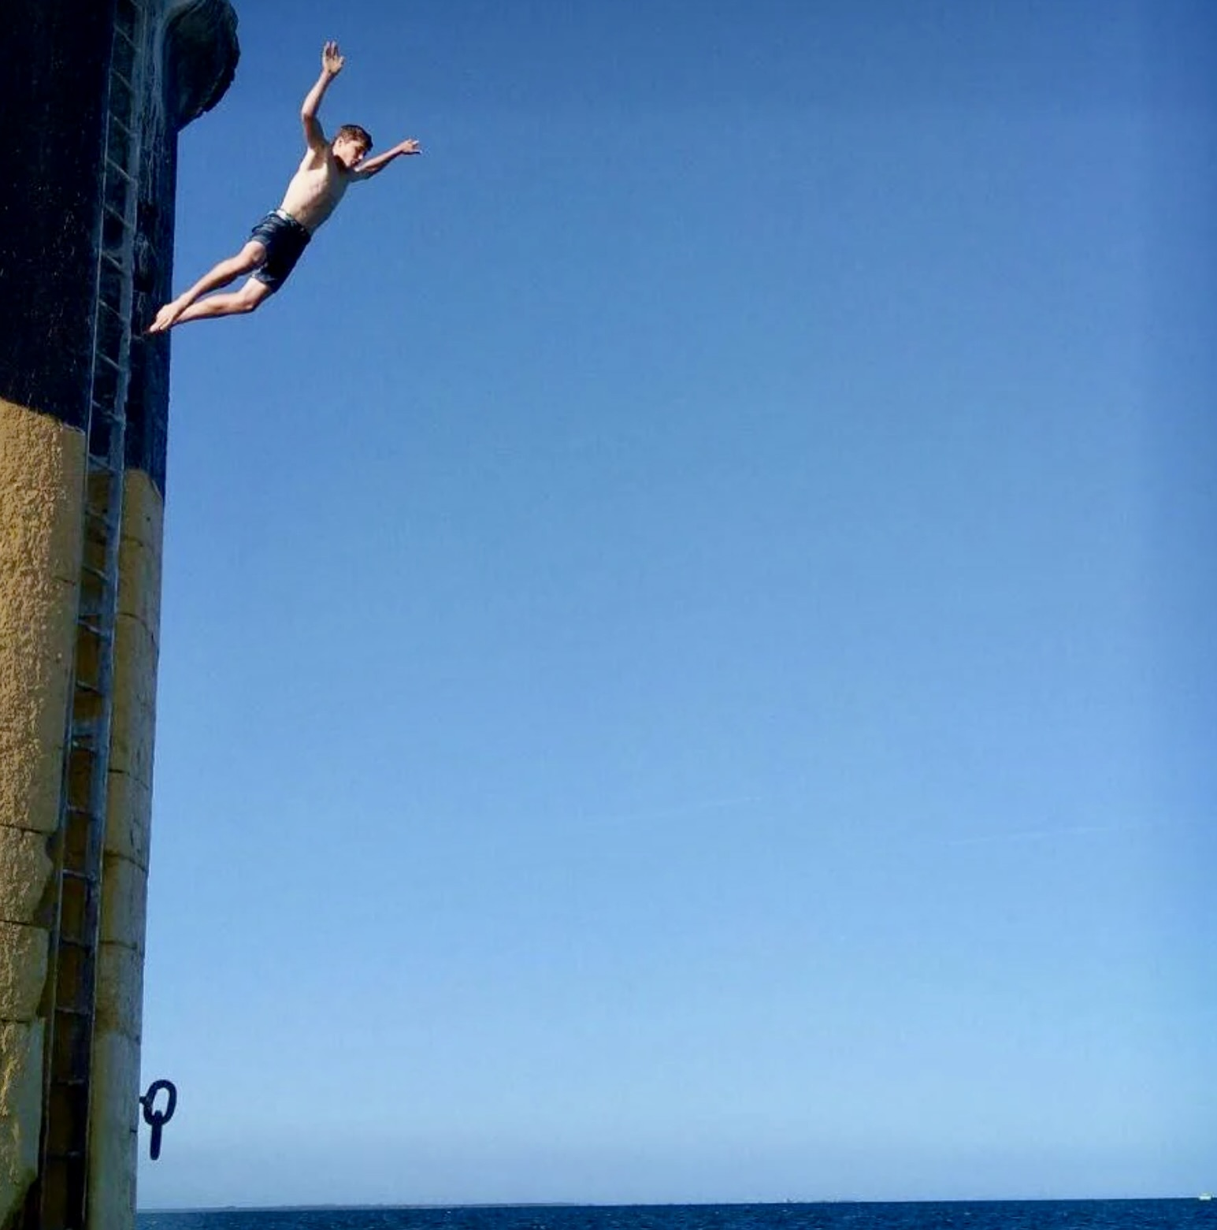
Who is this ?
Notes:
USE SLIDE WITH CAUTION FOR APPROPRIATE PARTICIPANTS ONLY
Arthur Fery article c/o Simin Briggs Telegraph 08/07/26
UK tennis player who got to the Wimbledon semi finals in 2026
Arthur says he took up cliff jumping at 15 to hone his mental strength
He claims not to be a risk taker but did this type if thing to work on losing fear and overcoming fear
However he got talked out of doing more by his parents as it wasn’t the smartest thing for a prospective professional athlete to do

Slide 42
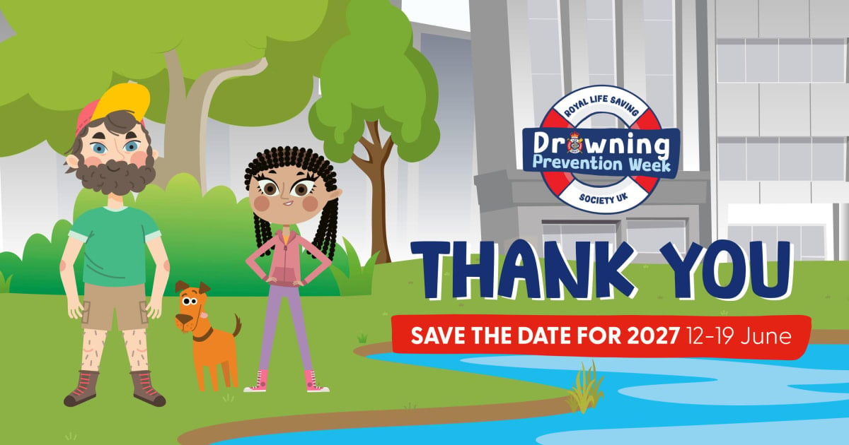
Drowning Prevention Week 2027
Notes:
Last year locally only Active Humber and the local RLSS created activity
With a years notice there could be far bigger push in 2027. KKC can offer a selection of activities throughout that week n
RLSS UK’s Drowning Prevention Week is an annual, water safety campaign designed to educate children and young adults in water safety and lifesaving skills.
Drowning Prevention Week educates children aged 5 to 17 each June with crucial water safety advice just before the summer holidays, when young people are outdoors more and need these skills and knowledge most, so everyone can enjoy water safely.
The RLSS are calling on all carers, schools, lifesaving clubs, leisure operators and water-related businesses to participate.
Powerful video from a previous year
https://youtu.be/cHw7c9Nj08U?is=a71f7QKvqicUa2mY

Slide 43
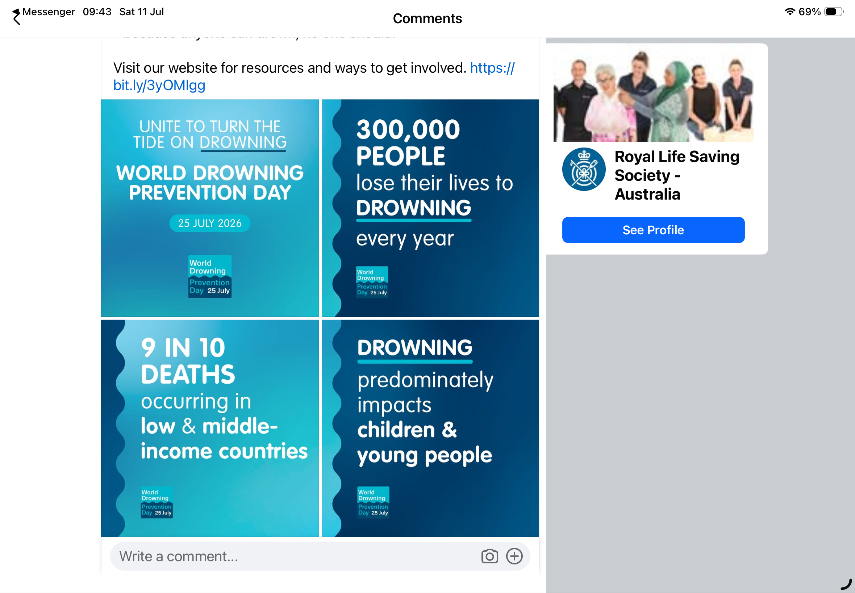
World Drowning Prevention Day 2026
Notes:
World Drowning Prevention Day 25 July 2026 is a global advocacy event recognised around the world.
Established by the World Health Organization (WHO), it highlights the tragic and profound impact of drowning on families and communities, as well as the life-saving solutions that prevent it.
In April 2021, the United Nations (UN) General Assembly affirmed drowning as a preventable global public health issue and declared 25 July as World Drowning Prevention Day.
Find Your Float is the National Water Safety Forum’s campaign for World Drowning Prevention Day. The campaign encourages as many people as possible to learn a lifesaving skill – the science-backed self-rescue technique of floating.
If you get into trouble in the water, knowing how to float can save your life. But we all float differently. By practising how to float in a safe and supported environment, people can learn what floating looks and feels like for them, better preparing them for an emergency situation.
National Water Safety Forum members and partners across the UK will be organising events and activities to help people find their float from 21 to 25 July 2026.
Drowning doesn’t have a single cause, or a single solution. But it can be prevented. Drowning is an issue that affects every nation of the world.
Globally, more than 230,000 people lose their lives to drowning every year. Drowning predominately impacts children and young people, with more than nine in 10 deaths occurring in low and middle-income countries, highlighting that vulnerable communities are most at risk.
Together, we can help ensure more people enjoy the water safely - because anyone can drown, no one should.

Slide 44





Inaugural event KKC 12th July 2026
Notes:
In Hull the first participants were given a certificate of achievement and a free swimming session

Slide 45
For further information contact
Dave Rawding
Senior White Water Coach Kingston Kayak Club
Mobile 07817 611249
E mail dave.rawding@me.com
Notes:
There is no intention to hold the intellectual rights of this material
Full recognition is given to those whose material have been used
The greater the collective effort is made on reducing unnecessary drownings the better
In the UK a greater emphasis needs to be made on ensuring that all those under 11 years can at least swim 25m
Starting September 2026, water safety education becomes a statutory requirement in England's RSHE (Relationships, Sex, and Health Education) curriculum. Schools must now teach students to recognize risks and stay safe around water using the Water Safety Code, while foundational swimming lessons remain compulsory in Key Stages 1 and 2
One of the challenges is a national shortage of swimming teachers

